Slide 1
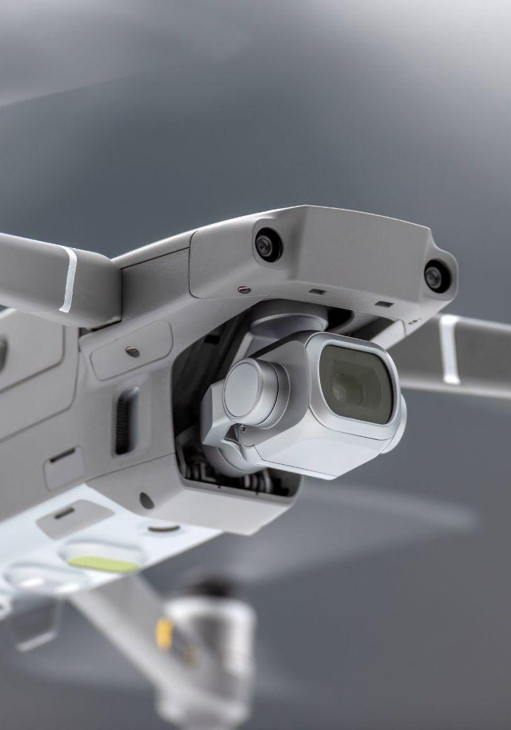
Convexum
Rotem Epelbaum
VP R&D
Confidential
©2022

Slide 2








How I Got Here
VP R&D – Counter Drones trough cyber
VP R&D – Israel Design center
Engineering Director – Internet Of Things
VP R&D – Client-side video acceleration
Director of R&D – Network Attached Storage
Software manager
Software developer
Software Developer – Real time embedded, Communication

Slide 3
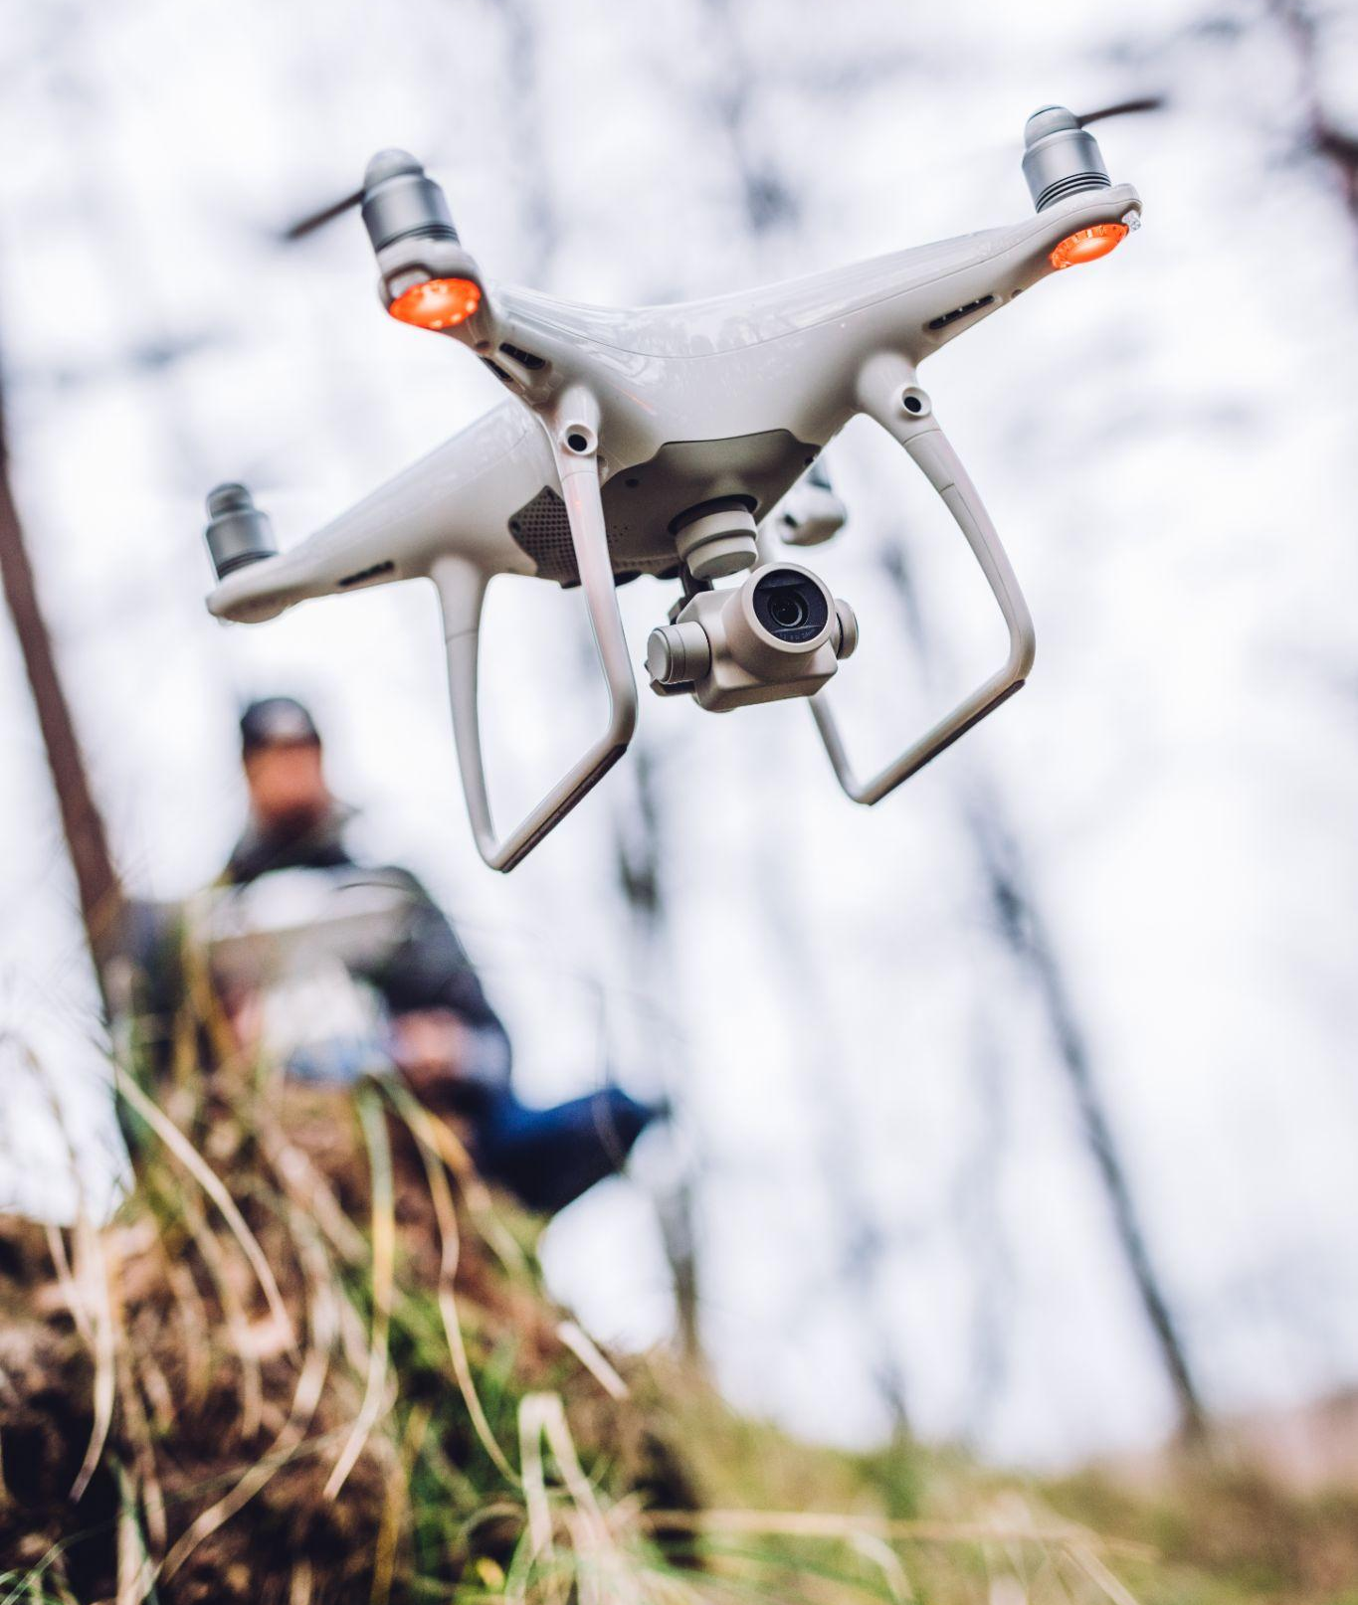

The premier cyber counter-drone platform. Designed to automatically detect, track, take over and safely land unauthorized drones in a designated zone.

Slide 4

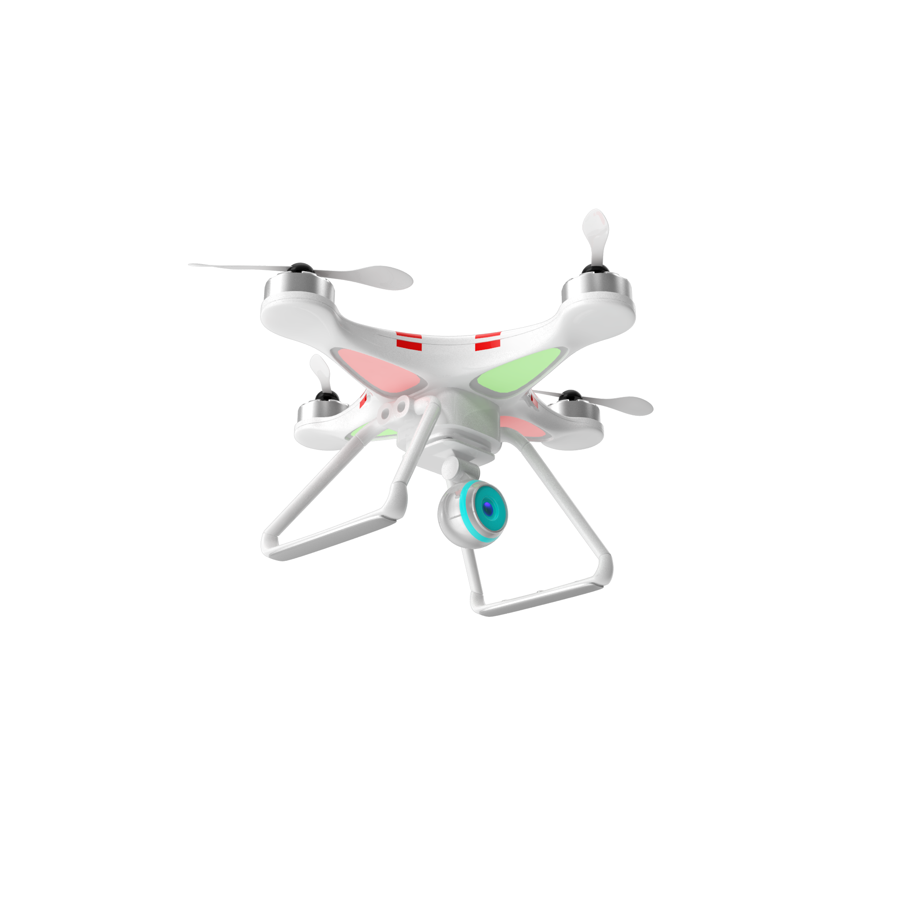
Protection Against Drones
Detection
Drones are small targets with low signatures which makes it difficult to detect and track drones by conventional means (radar and electro-optics)
Interception
Existing means using kinetic or electronic warfare means inflict massive collateral damage (jamming or spoofing)
Solution - Cyber
DETECT – Drone type
IDENTIFY – 3D location (Drone and Operator)
CONTROL – automatic take over and safely land

Slide 5
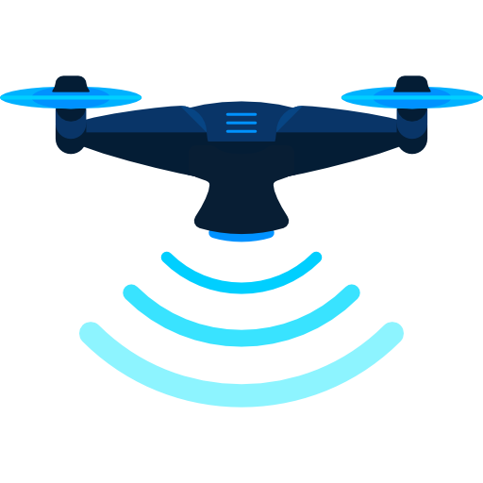


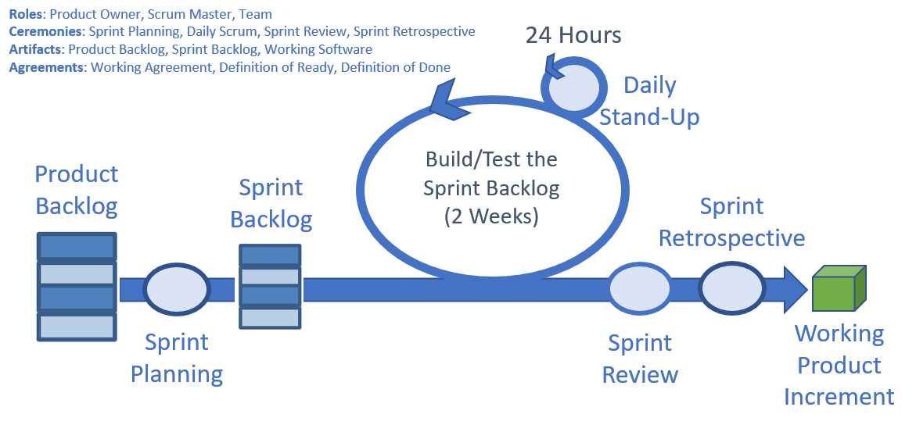

Scaled Agile Framework (SAFe)
Roadmap
Drones Coverage
Product Increment (PI)
3 months
4 Sprints
Official Release
Sprint
Execution
Performance: Speed and Distance
Command and Control Application
Device Management

Slide 6
Goal: Rapid Release, Significant Scope, High Quality & Security
Release
Sprint
Sprint
3 weeks
3 weeks
System Test
Release
Sprint
Release
Sprint
Next PI Planning
3 weeks
Sprint
3 weeks
Sprint
3 weeks
Sprint
3 weeks
Sprint
System Test
Next PI Planning
PI
PI

Slide 7
Thank You
We Are Hiring!
Leaders, Architects
Developers: Front end, Back end, Embedded, DSP
Testing: Manual, Automation
Customer Success, Pre-sale
Contact me on LinkedIn – Rotem Epelbaum

