Slide 1



מושב 2.3 - ראיה מערכתית והנדסת מערכות - יישומים ודוגמאות
יו"ר המושב: ד"ר אלכס בלכמן
אופטימיזציה מערכתית כבסיס לשינוי פרדיגמה בלוגיסטיקה והפצה
ד״ר סופי אמדור נלקה, HIT

Slide 2

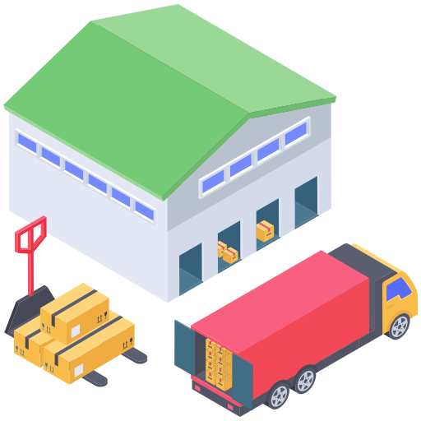

Notes:
And in order to do that, allow me to introduce “WeDeliver.com”, a company that delivers anything you ask for. They used to have a small warehouse, a single truck and several orders each day, which a small and well experienced staff easily handled.
*

Slide 3

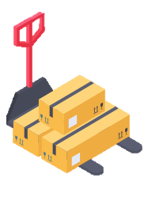

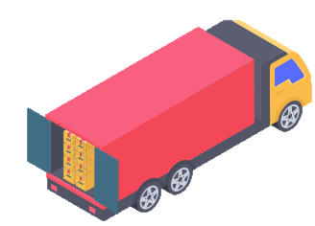

Notes:
But, as the world trade has shifted intensively towards online commerce, the number of orders they receive has grown immensely.
Efficient task allocation means more orders a day, and more orders a day, means higher income for WeDeliver.
Moreover, if they continue to have trucks following long routs through customers homes, they may not be able to keep up with the competition.

Slide 4
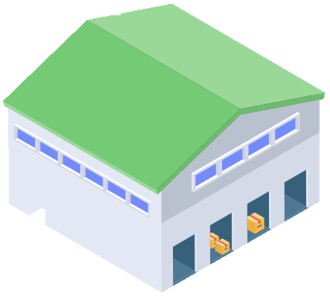
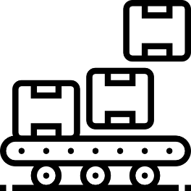


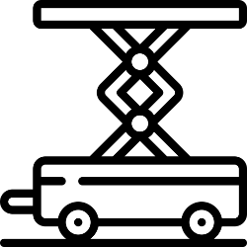
Pick and Pack Problem
1
3
2
4
5
Notes:
An ordering heuristic is used to determine the order among the tasks allocated.

Slide 5

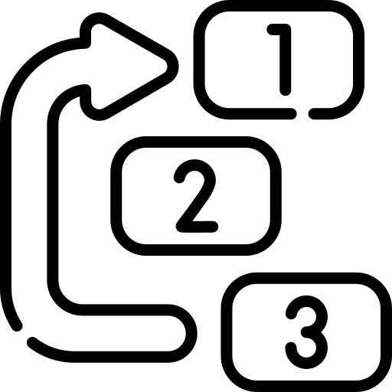
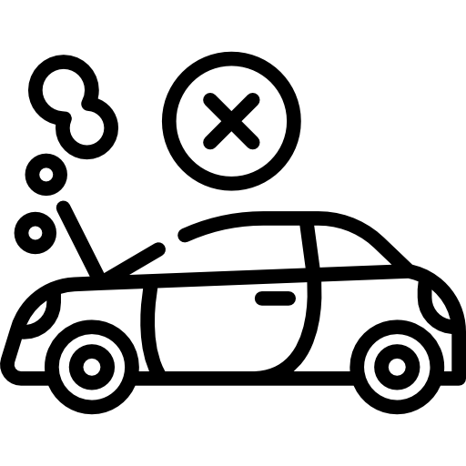
Pick and Pack Problem
Notes:
Now, this is a dynamic world!
Additional orders keep coming in.

Slide 6

Pick and Pack Problem
Notes:
Customers are willing to pay in order to get their packages faster.

Slide 7

Pick and Pack Problem
Notes:
Things can go wrong! A flat tire, broken machine or an injured worker.
The problem is not only complicated but highly dynamic as well, and efficient task allocation is critical!

Slide 8
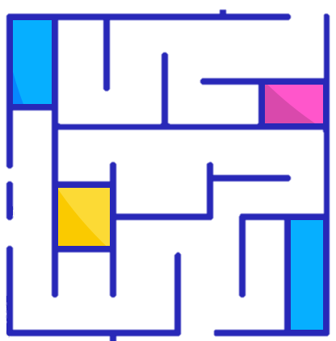

Routing problems
Notes:
Our solution is useful not only for the loading of the trucks at the warehouse, but also for the delivery to the customers homes.
Trucks drive to the neighborhoods where the packages are intended to be delivered.
Coalitions of scooters and drones take the packages to their destination homes.

Slide 9
The Last Mile Logistic
Last mile logistics is the last step in the delivery process.
The last mile begins as soon as a customer places an order.
The brand or logistics provider gathers and prepares the order for delivery and then delivers to the customer in the method chosen
Allow shippers to get more products to consumers faster and cost-effectively, both critical concerns in the e-commerce and omnichannel supply chain

Slide 10
The Last Mile Logistic
Robotic Warehouses.
  Orders arrive in an unpredictable rate.
  Each order requires a different combination of skills.
  Ad-hoc coalitions of robots with different skills serve different orders.
Package Delivery (Amazon, Volt…):
  Trucks carry packages to a delivery area.
  Scooters and drones perform the delivery.

Slide 11
The Last Mile Delivery Center
The warehouse or place where shipments are prepared to make their way to customers.
It must use technology and automation to ensure that their work is efficient to meet customer demands.

Slide 12



The Last Mile Logistics Challenges
Increase
productivity
Expenses
reduction
Lack of
human resources
“The warehouse and transportation industry had a record 490,000 openings in July”
Washington Post, Oct. 11, 2021
12

Slide 13
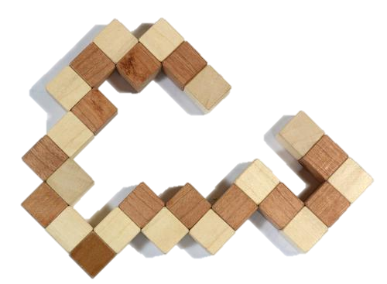
The Task Allocation Problem
Task allocation to human agents or autonomous devices
Managing heterogeneous teams
Handling upcoming tasks / developments in current tasks
Effective collaborative execution
Avoiding Single point of failure
(e.g., in case operation room collapses)

Slide 14
Our
Solution
Notes:
In order to solve the problem, we first represent it in math.

Slide 15
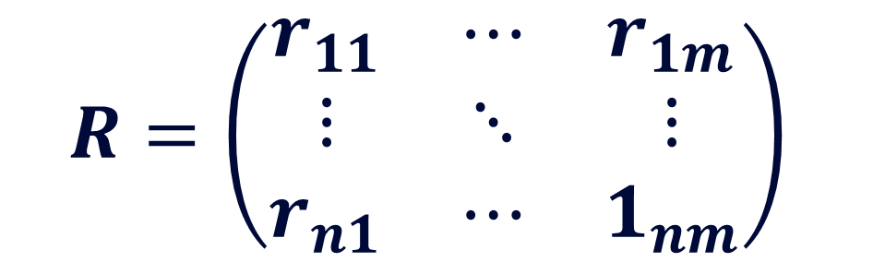

Problem Formulation
$$R=\left(\begin{matrix}r_{11} & ⋯ & r_{1m} \\ ⋮ & ⋱ & ⋮ \\ r_{n1} & ⋯ & 1_{nm}\end{matrix}\right)$$
Our
Solution
$$r_{ij}=\sum_{k=1}^{n}{{[\left(α_{k}+β_{k}\right)}^{0.5 }+\left(1_{k}−σ_{k}\right)ρ_{k}+\left(σ_{k}\right)μ_{k}+δ_{k}]−π }∀γ∈Γ$$
Notes:
Then we reduce the mathematical model so it can be fed into a multi agent task allocation algorithm.

Slide 16
Problem Formulation
Reduction to Task Allocation Model
$$R=\left(\begin{matrix}r_{11} & ⋯ & r_{1m} \\ ⋮ & ⋱ & ⋮ \\ r_{n1} & ⋯ & 1_{nm}\end{matrix}\right)$$
Our
Solution
$$r_{ij}=\sum_{k=1}^{n}{{[\left(α_{k}+β_{k}\right)}^{0.5 }+\left(1_{k}−σ_{k}\right)ρ_{k}+\left(σ_{k}\right)μ_{k}+δ_{k}]−π }∀γ∈Γ$$
Notes:
Then, we perform a reduction that allows to solve the task allocation problem using a multi-agent market-based algorithm.

Slide 17

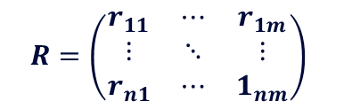
Problem Formulation
Reduction to Task Allocation Model
Task Allocation Algorithm
Our
Solution
$$R=\left(\begin{matrix}r_{11} & ⋯ & r_{1m} \\ ⋮ & ⋱ & ⋮ \\ r_{n1} & ⋯ & 1_{nm}\end{matrix}\right)$$
ALLOCATION

Slide 18
Problem Formulation
Reduction to Task Allocation Model
Task Allocation Algorithm
Our
Solution
Unordered Allocation of Tasks
Notes:
The result of the algorithm is a division of tasks among the agents and coalitions for handling shared tasks.

Slide 19
Problem Formulation
Reduction to Task Allocation Model
Task Allocation Algorithm
1
3
Our
Solution
2
4
Unordered Allocation of Tasks
Ordering Heuristic
5
Notes:
An ordering heuristic is used to determine the order among the tasks allocated.

Slide 20
Problem Formulation
Reduction to Task Allocation Model
Task Allocation Algorithm
Our
Solution
Dynamic Event
Unordered Allocation of Tasks
Ordering Heuristic
Notes:
When a dynamic event occurs

Slide 21
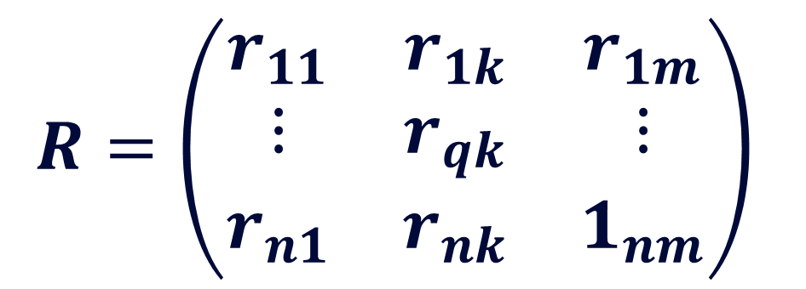
Problem Formulation
Reduction to Task Allocation Model
Problem Model Update
$$R=\left(\begin{matrix}r_{11} & r_{1k} & r_{1m} \\ ⋮ & r_{qk} & ⋮ \\ r_{n1} & r_{nk} & 1_{nm}\end{matrix}\right)$$
Task Allocation Algorithm
Our
Solution
Dynamic Event
Unordered Allocation of Tasks
$$r_{ij}=\sum_{k=1}^{n}{{[\left(α_{k}+β_{k}\right)}^{0.5 }+\left(1_{k}−σ_{k}\right)ρ_{k}+\left(σ_{k}\right)μ_{k}+δ_{k}]−π }∀γ∈Γ$$
Ordering Heuristic
Notes:
The mathematical model is updated

Slide 22
Problem Formulation
Reduction to Task Allocation Model
Problem Model Update
$$R=\left(\begin{matrix}r_{11} & r_{1k} & r_{1m} \\ ⋮ & r_{qk} & ⋮ \\ r_{n1} & r_{nk} & 1_{nm}\end{matrix}\right)$$
Task Allocation Algorithm
Our
Solution
Dynamic Event
Unordered Allocation of Tasks
$$r_{ij}=\sum_{k=1}^{n}{{[\left(α_{k}+β_{k}\right)}^{0.5 }+\left(1_{k}−σ_{k}\right)ρ_{k}+\left(σ_{k}\right)μ_{k}+δ_{k}]−π }∀γ∈Γ$$
Ordering Heuristic
Notes:
And following it, the model reduction. We solve it once more and update the agents that their tasks have changed...

Slide 23
Problem Formulation
Reduction to Task Allocation Model
Problem Model Update
Task Allocation Algorithm
Our
Solution
Dynamic Event
Unordered Allocation of Tasks
Ordering Heuristic
Notes:
This is how Dynamacs efficiently adapts to the dynamic problem.

Slide 24
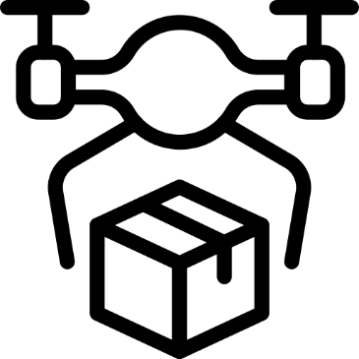




We maximize the performance of teams in dynamic environments
Notes:
And that is where we come in! Dynamacs. We maximize the performance of teams in dynamic environments.

Slide 25
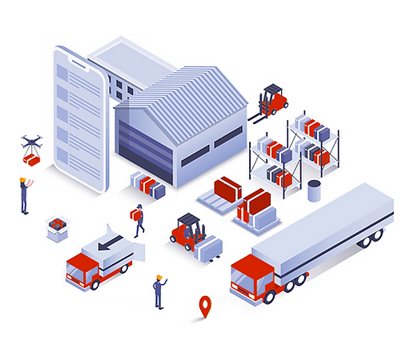


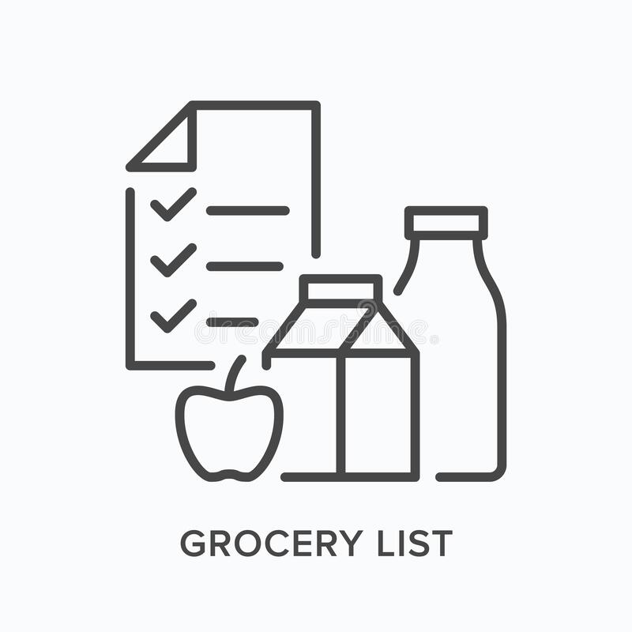
Our Solution
Provide a Dynamic Task Allocation solution based on a proprietary algorithm (patent)
Order 113-125
Order 113-124
Order 113-123
Order 113-122
Order 113-121
customers online orders
Last Mile prioritized the orders
Dynamic multi-agent tasks Allocation
Last Mile orders' fulfillment

Slide 26
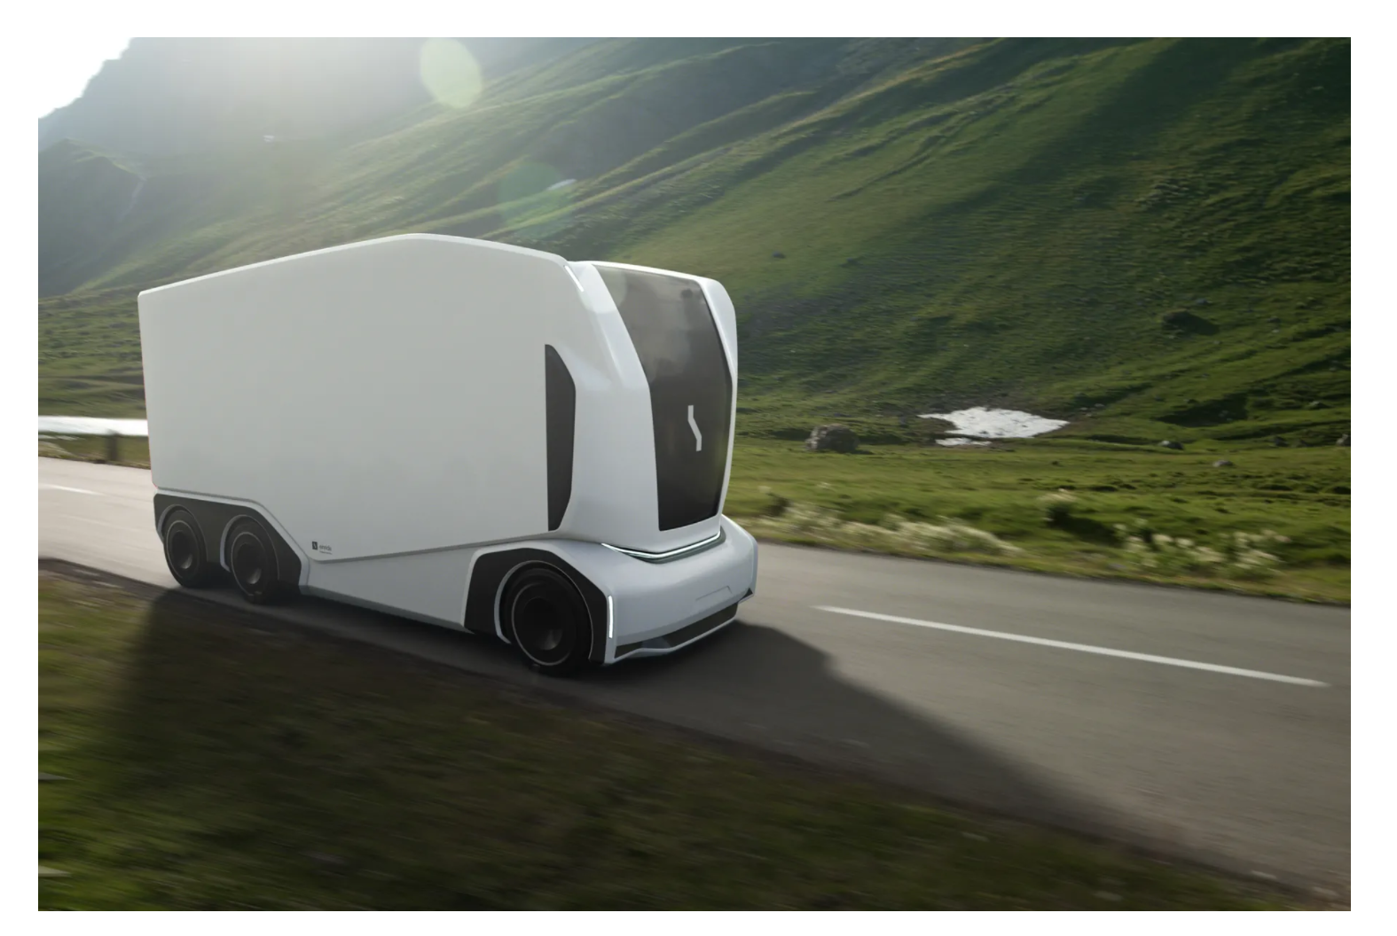
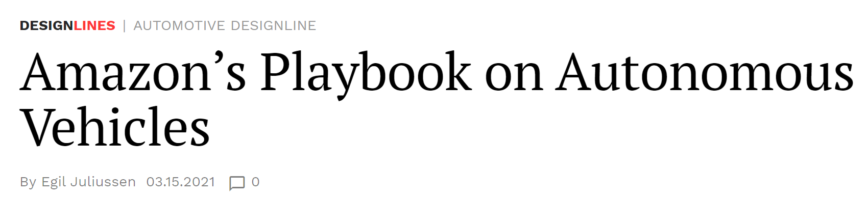
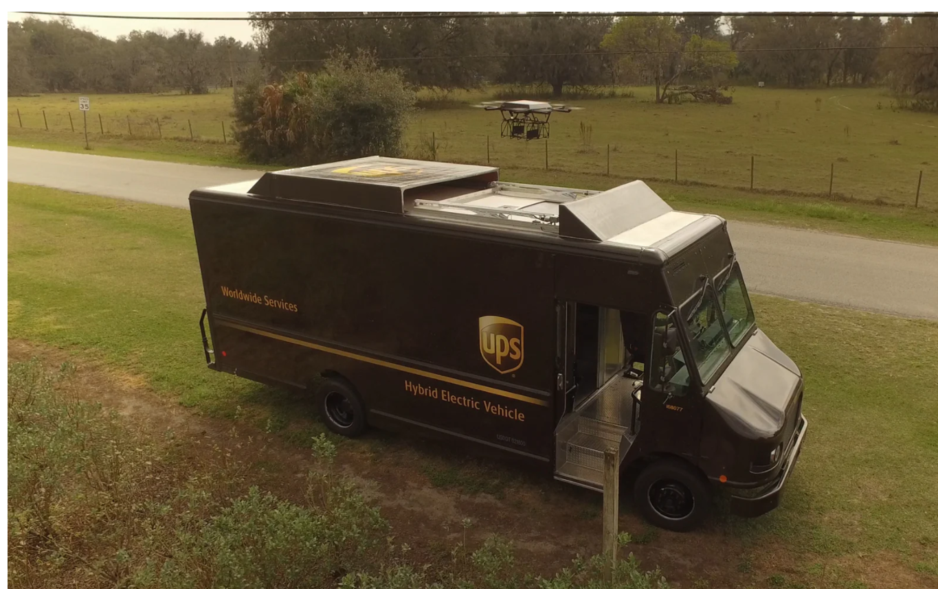
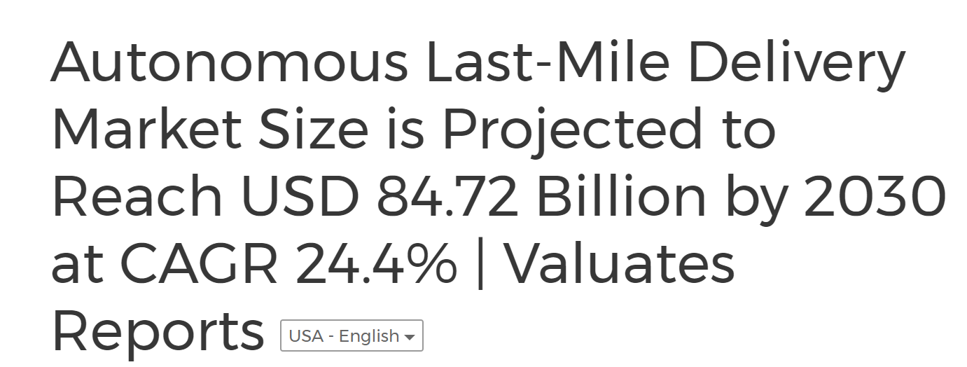
Package Delivery takes a New Form…

Slide 27
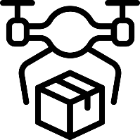

Last Mile Package
Delivery
Notes:
Our solution is useful not only for the loading of the trucks at the warehouse, but also for the delivery to the customers homes.
Trucks drive to the neighborhoods where the packages are intended to be delivered.
Coalitions of scooters and drones take the packages to their destination homes.

Slide 28
Last Mile Package
Delivery
Notes:
and bring items that the customers want to return, back to the trucks.

Slide 29
Last Mile Package
Delivery
Notes:
The trucks go back to the warehouse while the scooters and drones remain in the distribution area to serve other trucks.

Slide 30
The package delivery problem (PDP)
A general description of scenarios which include:
  A warehouse in which packages are stored.
  The packages need to be delivered to customers in a city.
  The packages are loaded to trucks, according to the neighborhoods (distribution areas) in the city, i.e., two packages intended for the same neighborhood will be loaded to the same truck.
  The trucks travel to a location in the center of the neighborhood, to which the packages they carry are intended to be delivered to.

Slide 31

The package delivery problem (PDP)
  The packages are unloaded from the trucks and delivery UAVs (e.g., drones) and UGVs (e.g., scooters), carry them to their customer’s addresses.
  When this task is completed, a truck returns to the warehouse to reload packages.
  The drones and scooters can be reassigned for delivering packages from other trucks.
Dynamic Elements:
  Change in delivery urgency (e.g., call from customer).
  Vehicle breakdown.

Slide 32
Solving PDP using FMC-TA
We propose the use of Fisher Market Clearing Task Allocation (FMC_TA) for solving package delivery problems, as described above.
We consider a task to be the delivery of packages in a certain area.
For each package delivered there is a utility that is derived, depending on the time of delivery (a monetary value).
The coalition of agents that attend to a task must include at least one truck that brings the relevant packages to a centered position in the area of delivery.
Scooters or drones or both, which take packages from the trucks and deliver them to the delivery address.
Timing is critical!
The allocation of agents to coalitions is done using the FMC_TA algorithm, which we have previously proposed.

Slide 33
Solving PDP using FMC-TA
The innovation is in representing this problem as a task allocation problem that can be solved using this algorithm.
Notice that an agent (drone or scooter) can be a member in a number of coalitions, thus:
  After delivering a package from one truck in a certain area, it can deliver a package from another truck in a nearby area.
Moreover,
  When the truck is emptied, and it returns to the warehouse to reload packages,
  drones and scooters can cooperate with other trucks and keep deliver.
  Battery charging and fulling can be done in specific points near the areas of delivery.

Slide 34
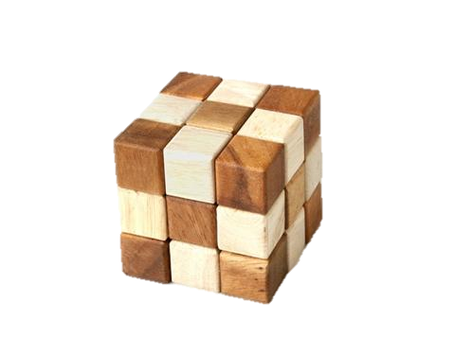
The Task Allocation Solution
Dynamic Distributed Task Allocation System
Can be applied in: Vehicles, Robots, Drones etc.
Performs in highly dynamic situations with uncertainty.
Effective utilization of resources
Efficient collaboration among heterogenous resources.

Slide 35
The Task Allocation Solution
Prioritizes tasks of high importance.
Does not depend on mass existing data.
Centralized or distributed implementation (similar results).

Slide 36




Central
Distributed
Notes:
The system can operate centrally, e.g., on the warehouse computer or distributively by the robots, computers and the human’s phones.

Slide 37

Central
Distributed
Notes:
The results would be the same, but a distributed implementation will not block the main warehouse computer and will continue to work when this computer fails.

Slide 38

Central
Distributed
Notes:
For the delivery tasks, distributed implementation generates a robust system that allows the delivery vehicles to perform even under communication limitations.

Slide 39
Our Mission
Accelerate TTM
The algorithm starts
to perform on day 1
Plug and play
Fully autonomous
Realtime scalability
Once the algorithm definition is completed the scale is unlimited
Cost effective
Low processing,
Low data consumption,
pure software solution
On Demand
Dynamic response to missions & agents changes.
39

Slide 40

Increasing service levels
Notes:
Dynamacs allows WeDeliver not only to increase service level, but also to adopt new technology

Slide 41


Increasing service levels
Adopt technology

Slide 42

The way to the future
Notes:
Because when you have humans following the instructions of a task allocation algorithm, replacing them by machines and robots replace becomes a smooth prosses.

Slide 43



Summary
Paradigm shift
Dynamic approach
Cost effective
“over 5 million parcels per day may be delivered late during the holiday season and the Christmas week” (Jeff Berman, Logistics Management, September 23, 2021)
43

