Slide 1



הדגמת גישות יישומיות בהנדסת מערכת בתעשיות ההייטק - שלמה וולפמן
From Data to Insights
Dr. Osher Yadgar
PANGEA

Slide 2
From Data to Insights
Show Me Your Data and I’ll Show You the Money
Dr. Osher Yadgar
Director of Data Science
Date: 14 of Sep. 2022

Slide 3

Personal Profile
Business Experience
  Pangea: Director of AI
  LivePerson: Director of Applied Science
  Jacada: Head of AI
  myThings: Chief Data Officer
  Conduit: Chief Scientist
Research Expertise
  Former Senior Scientist at
  AI Center of Stanford Research Institute
  Research Domains: Virtual Personal Assistant, Smart Grid, Autonomous Unmanned Aerial Vehicles (UAVs), Development of Machine Learning Algorithms for large scale autonomous systems
Osher Yadgar Ph.D.
Artificial Intelligence

Slide 4

About Pangea
Civil Registry
ePayment Platform
National census, social security and voter registration
Supports wide range of debit card
and mobile app transactions
Public Records
Social Services
DIGITAL
IDENTITY
Multi Sensor
ANALYTICS
DIGITAL
SERVICES
Transfer of social benefits including
pensions; child allowance etc.
Birth and Death Certificates |
Marriage and Divorce Certificated
Personal ID Cards
Taxes and Fees
National ID | Social Security |
Driver License | Resident Card | Employee ID
Income tax payments, social insurance and service charges
Access Control
Sensor Analytics
CCTV Monitoring |Bio-Therma
COVID-19 detection| Intrusion
detection
IoT devices | Telco towers
Smoke, motion & noise detectors
e-Travel Documents
Public Sector Payroll
Validation and transfer of public sector
employee salaries and benefits.
E-Passports | Visas| Immigration Permits Work Permit | Student Visa | Refugee Card
Video Analytics
Behavioral Analytics
Face recognition | Abandoned Object People Queuing| Theft & Shoplifting
Aggressive behavior, loitering |
Heatmap analytics
Data Pool
Insights Platform
4
Note: Pangea products fully comply with ICAO and ISO digital document identification standards and requirements, as necessary.
Notes:
1. Digital Identity: Provides government records and identification documents (biometric IDs, birth certificates, marriage licenses, divorce certificates, e-travel documents).
2. Digital Services: Enabling the transfer of services, benefits and financial transactions via a secure biometric debit card and mobile e-payment application.
3. Digital Analytics: AI-driven analytics platform enabling customers to increase operational efficiency, improve quality of services and generate new revenue streams.

Slide 5











Digital Transformation AI-Driven Platform
1
Digital Identity
Databases
Applications
Government records
Biometric ID Cards
E-Travel Documents
Processing Engine
Analytics Engine
2
Identity
Data
Data Lake
Reports
Digital Services
Heuristic &
AI Models
Social Benefits
Public Services
Financial Transactions
Transactional
Data
BI Data cube
Dashboards
Data Processing
Engine
Normalized
Data
3
Digital Analytics
Unstructured
Data
Services
Multi-sensor data
Access Control
Incident Management
Applicable Security Standards
All Pangea modules comply with ISO/IEC 27001:2013, “Information Security Management Requirements”.
Devices
5

Slide 6
Real World Use Cases
Cell Tower Maintenance
HIV Treatment
Civil Registry

Slide 7
Happy Path vs. Real Life
Domain Expertise
Inhouse domain knowledge, cause and effect
Communication with domain experts and client
Data
Availability – full/partial. files/db,
Quality – unambiguity, incompleteness
Quantity
Maintenance and organization

Slide 8
Who Is The King?
Expert Driven Approach
Data Driven Approach

Slide 9


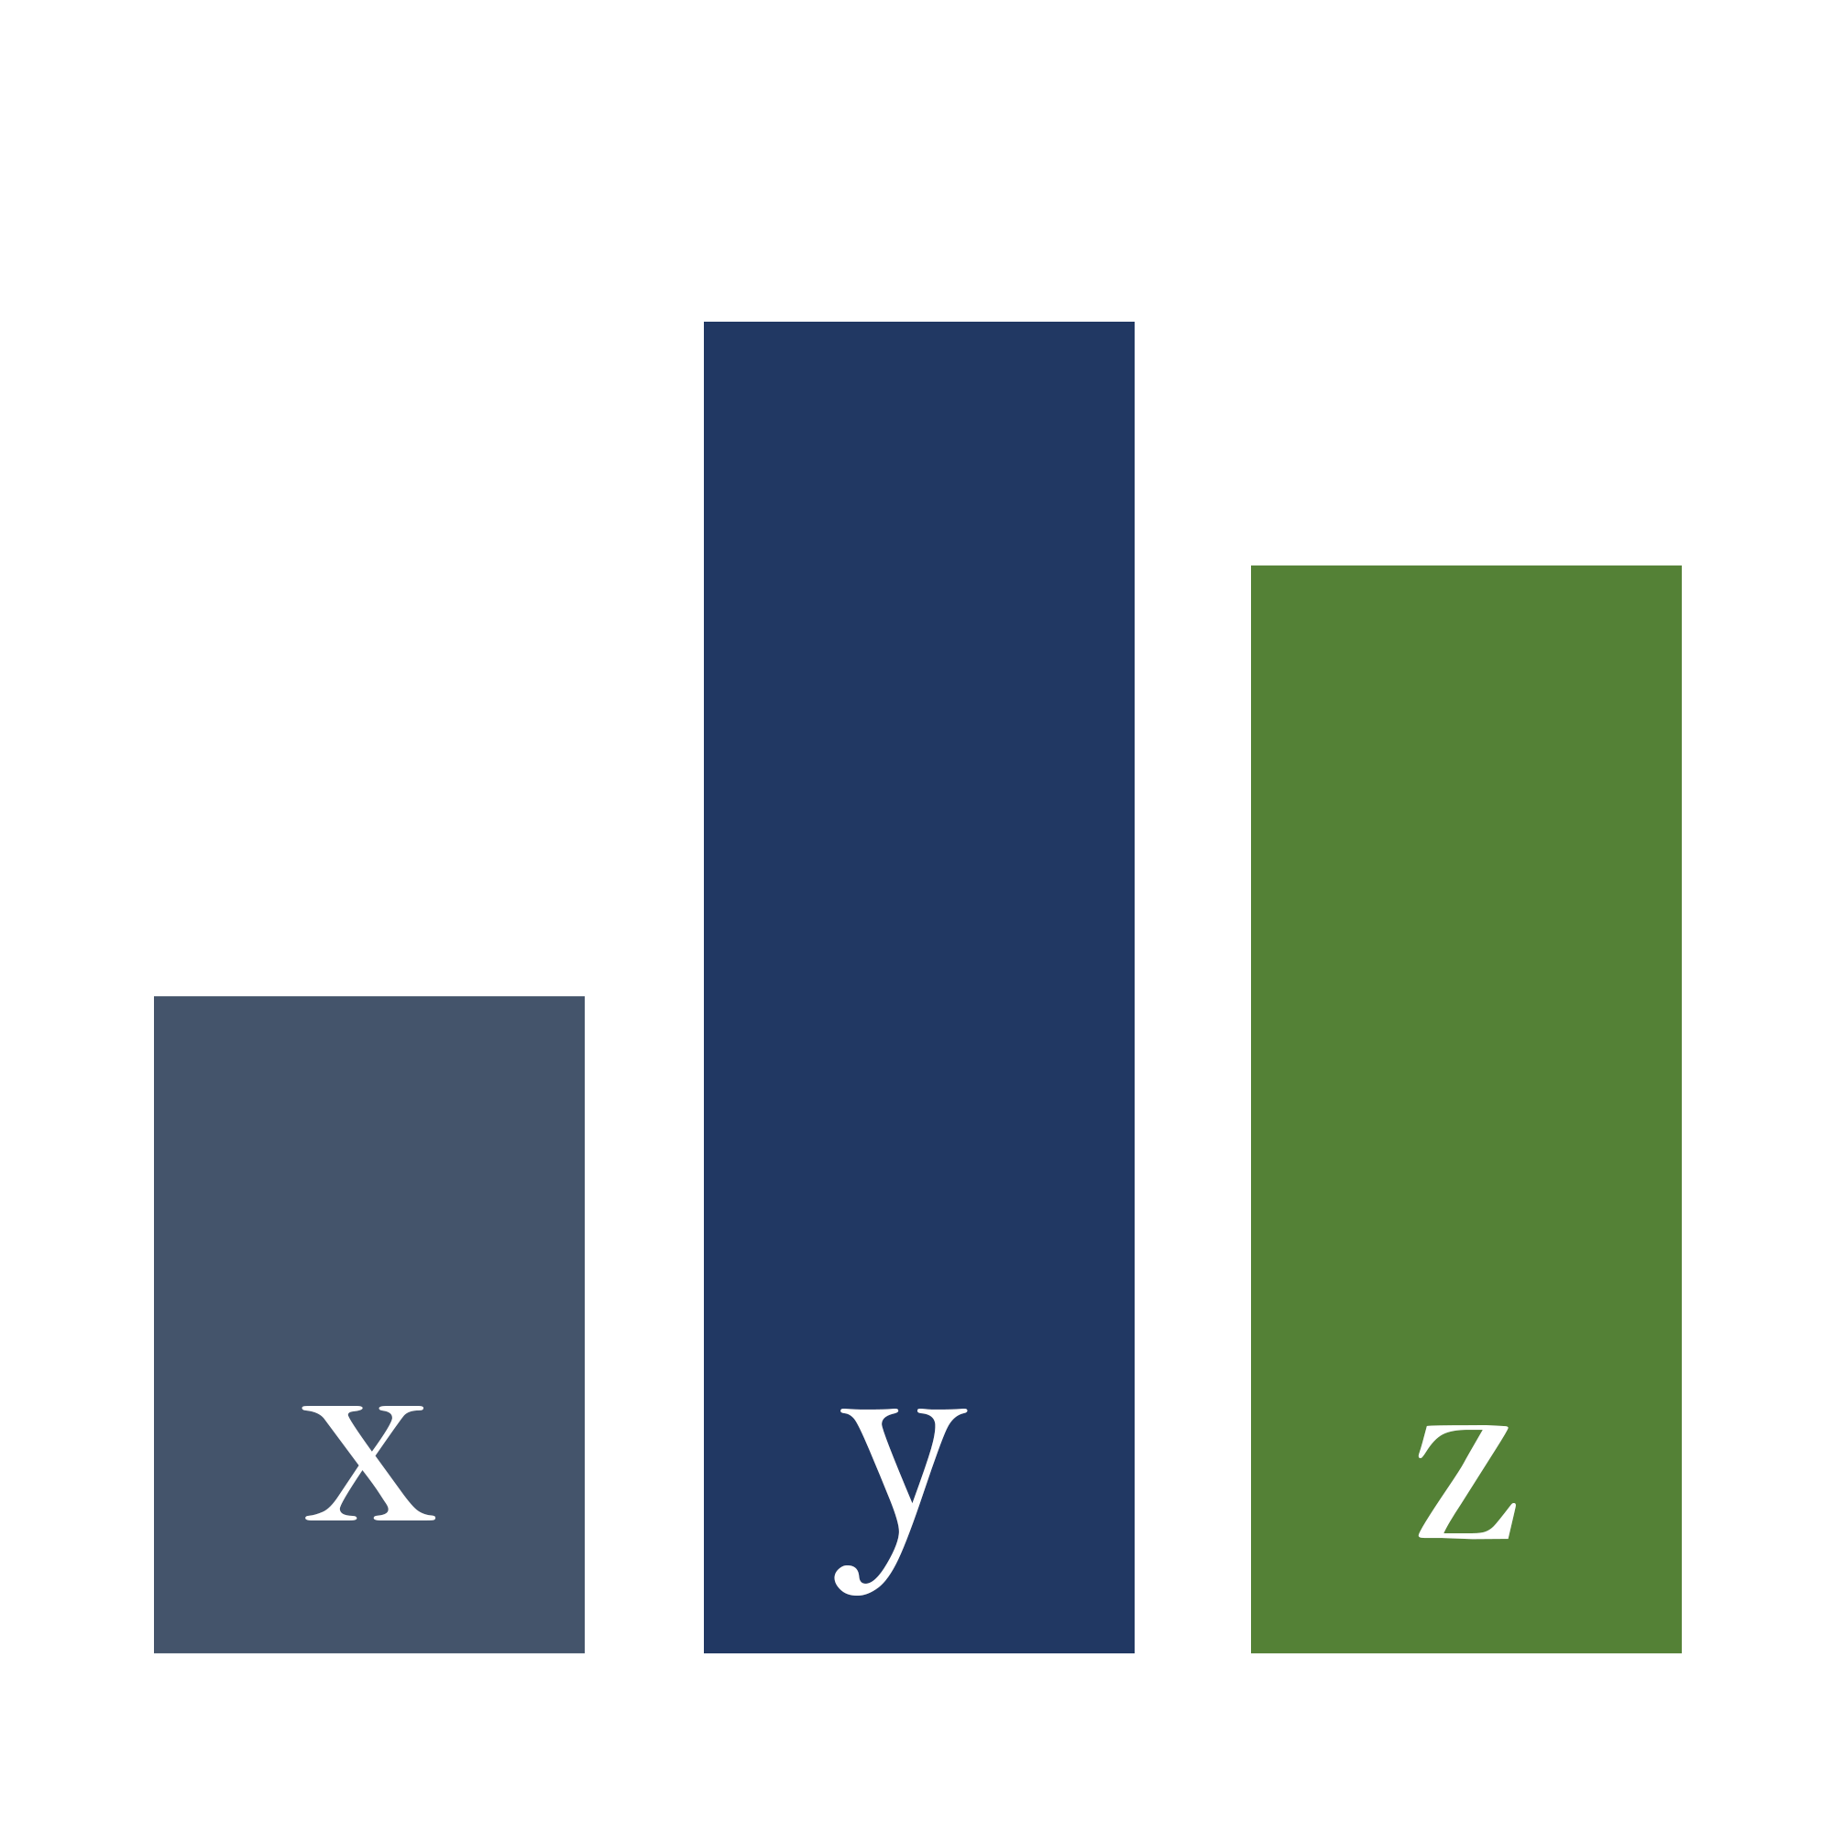


Data Driven Systems Evolution
Actions
Insights
Next Best Action
Dashboards
Get the right data
Future
Past
Notes:
Data
Unstructured vs. Structure
Descriptive
Describe what happened
Employed heavily across all industries
Predictive
Anticipate what will happen (inherently probabilistic)
Employed in Data Driven organizations
Prescriptive
Provide recommendations on what to do

Slide 10
Challenges
Organization engagement
Get the right data
Value proposition
for customer

Slide 11

Approach
Show me the money !
MVD - Small data prototyping
Result - Organization engagement

Slide 12
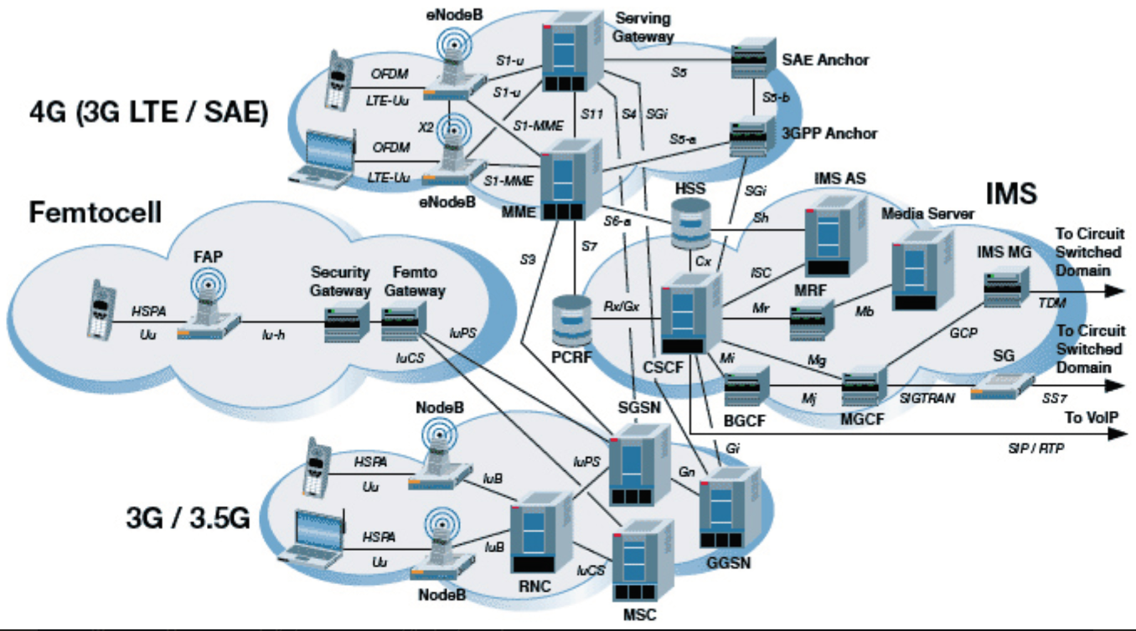
Cell Tower Maintenance
Fully integrated multi sensor insights solution
RAN
CORE

Slide 13
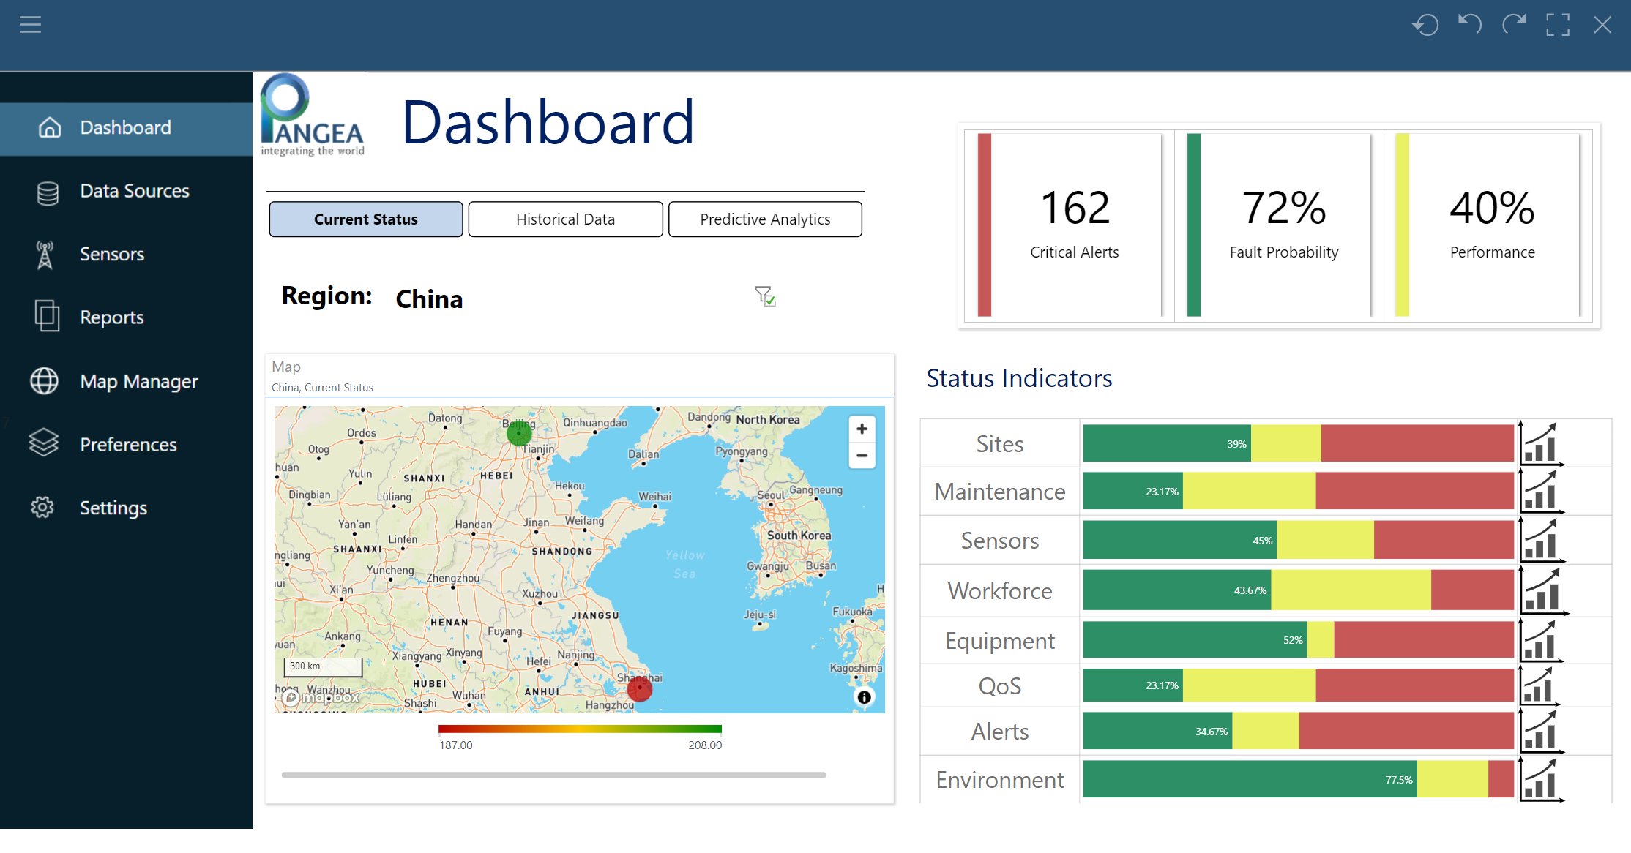

Slide 14
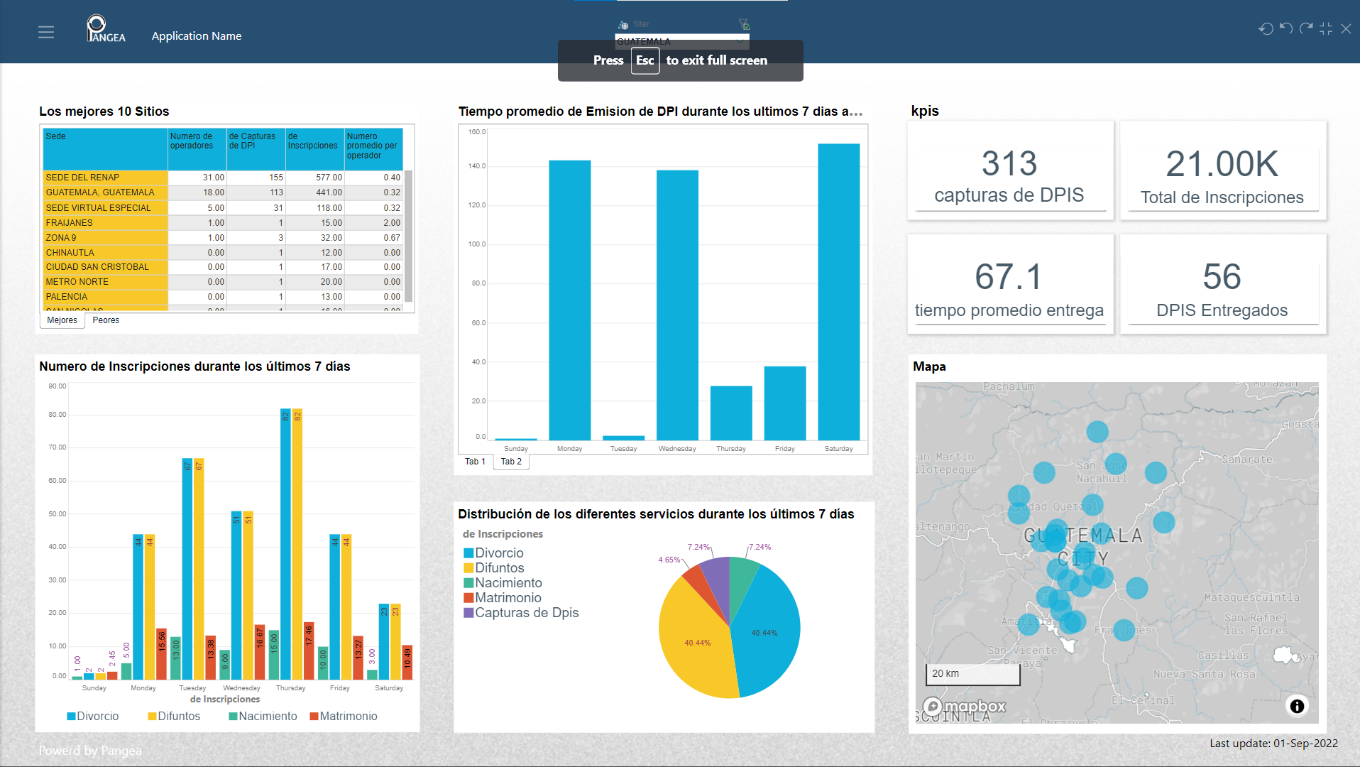
Civil Registry

Slide 15
Save the high annual cost generated by the rejections
Reduce the average time of issuing identification cards.
Improve the quality of service to the citizens
Hierarchical representation
Country, State, Municipality, Site
Geolocation
Data Generators
KPIs

Slide 16
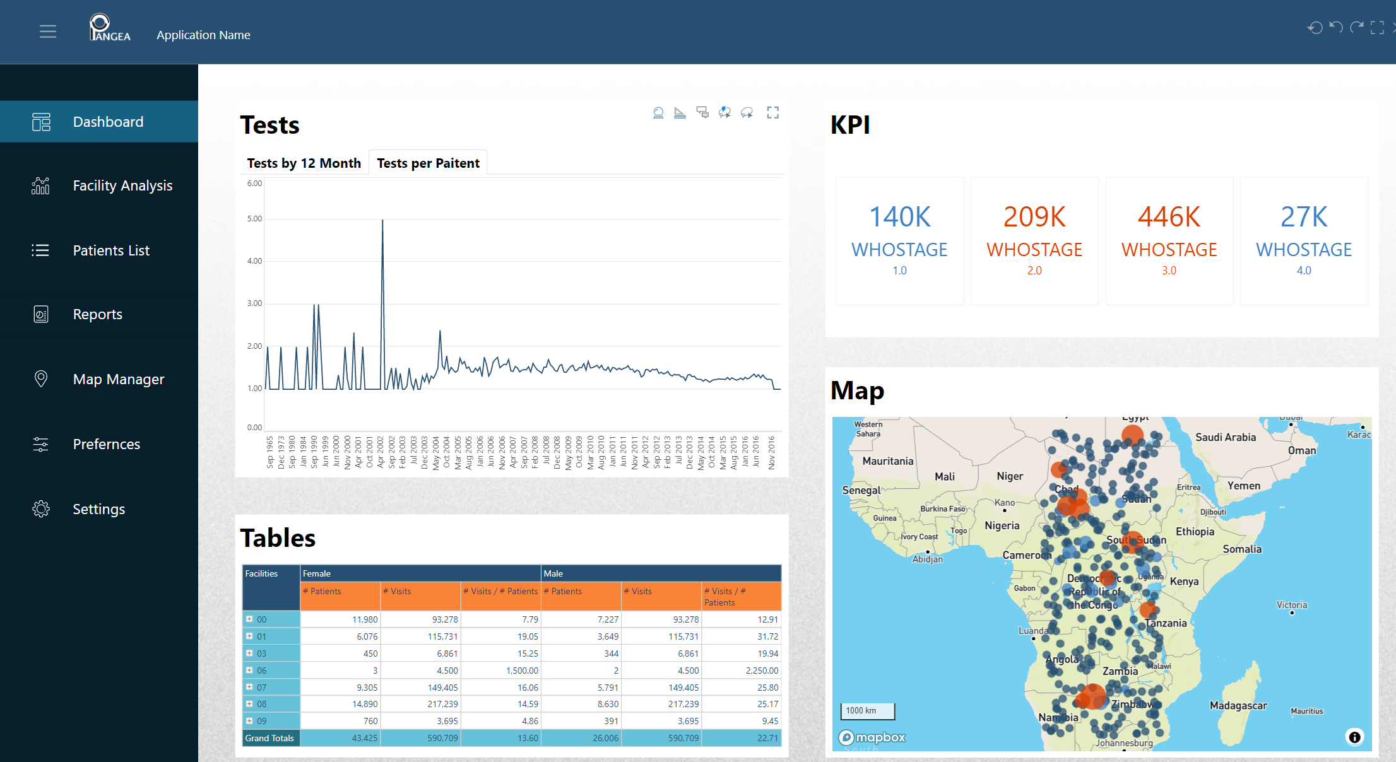
HIV Treatment

Slide 17
Choosing Treating Facility Is Important

Slide 18
Should Increase Awareness for Voluntary Counseling

Slide 19
Take away
Everything is a system
Collection of objects with mutual relations
Any system generates data
It is not trivial to identify the relevant valuable data
Life cycle should be data driven
Design – maintenance – expansion - roadmap
Agile approach to data is a must
Start with small data , demonstrate value , and expand

