Slide 1
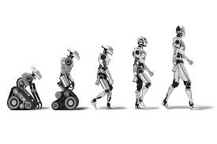
Introduction to Machine Learning
Lea Polachek
052-4486362
lea@primrose.co.il

Slide 2
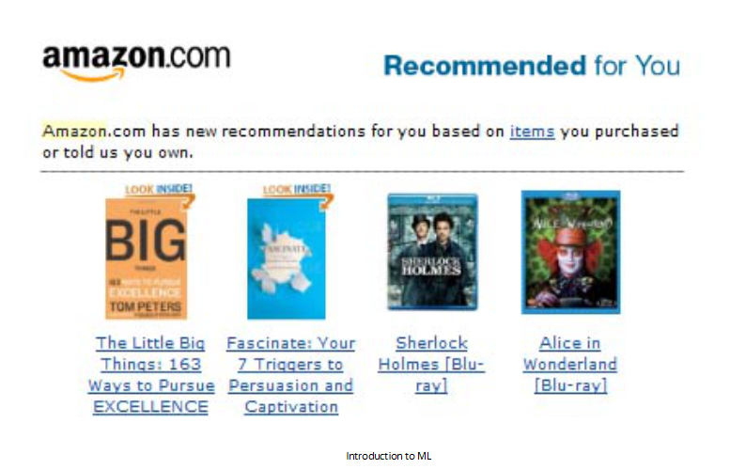

Slide 3
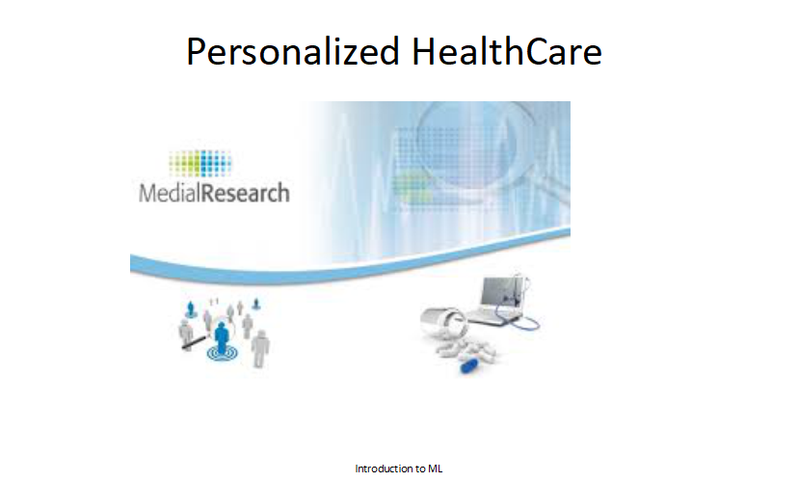

Slide 4


Slide 5
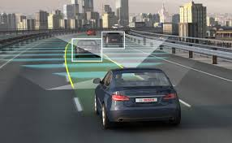

Slide 6


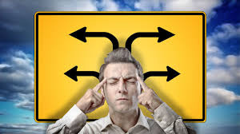
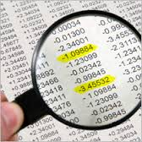
Advice and decisions
Fraud detection

Slide 7
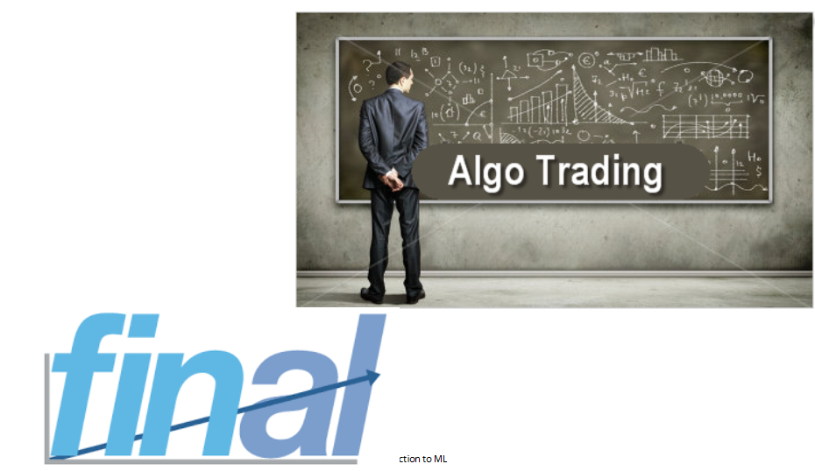

Slide 8
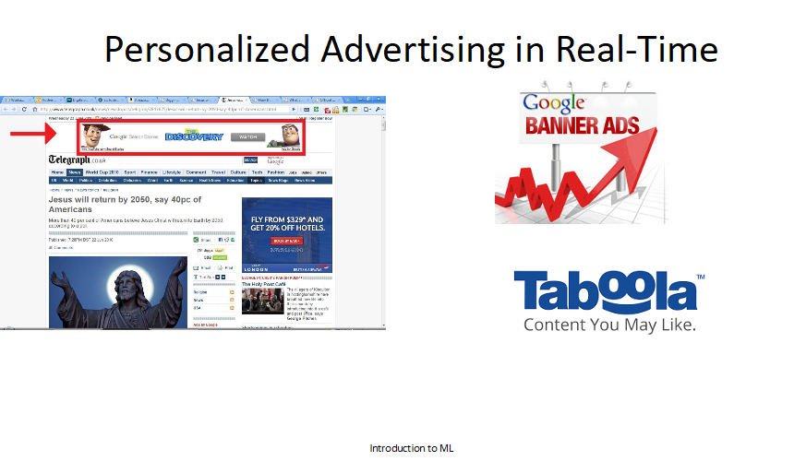

Slide 9
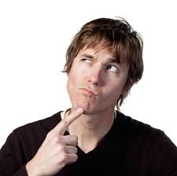
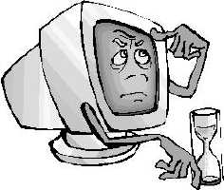
Rules based vs Machine Learning
Machine learning
Person learning

Slide 10
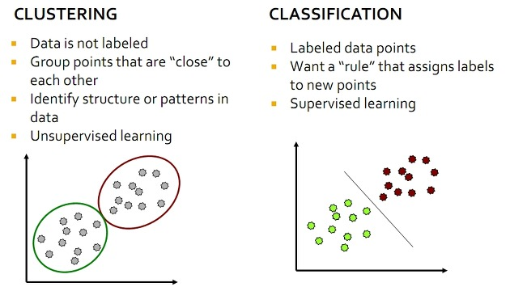
Star data

Slide 11
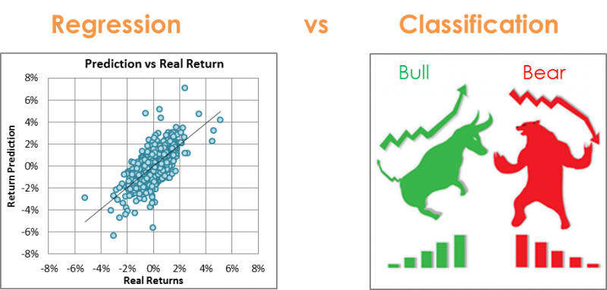

Slide 12
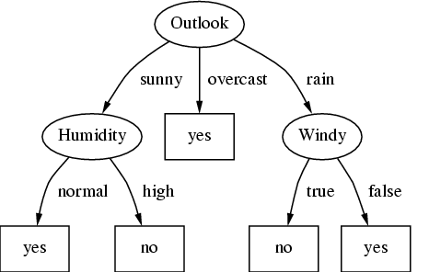
Decision Trees

Slide 13
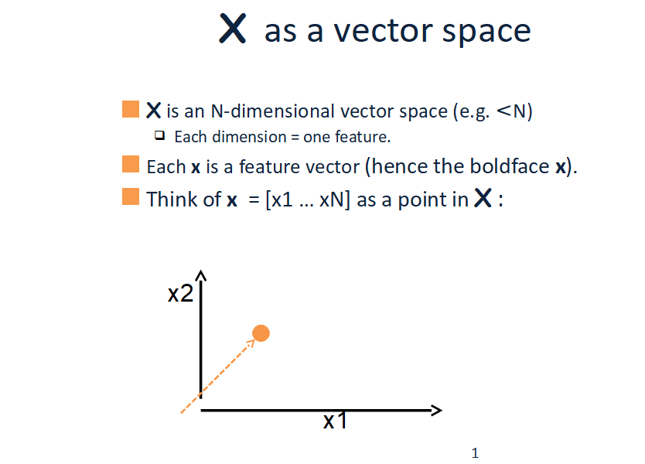

Slide 14
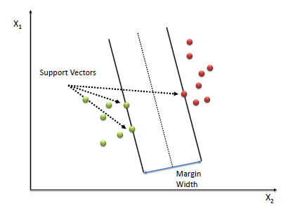
Support Vector Machines
Red: likes apple suace
Green: hates apple sauce
Curr
Age
First age to eat apple sauce

Slide 15
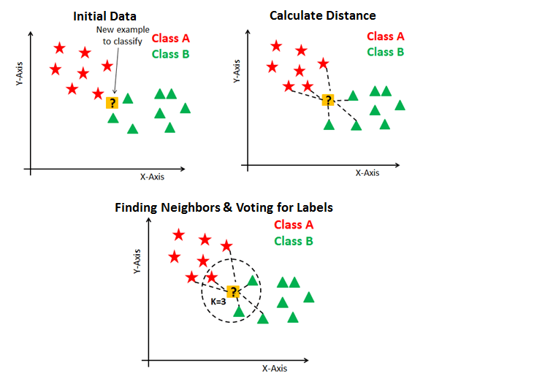
K-NN k nearest neighbours

Slide 16
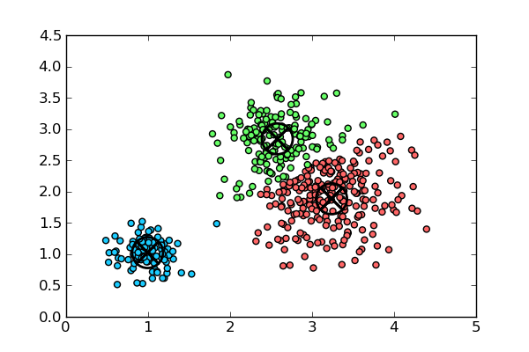
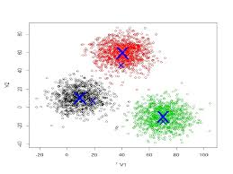
K - Means
http://shabal.in/visuals/kmeans/2.html
k-means

Slide 17
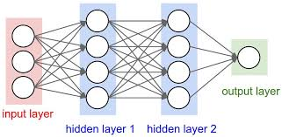
Neural Networks

Slide 18
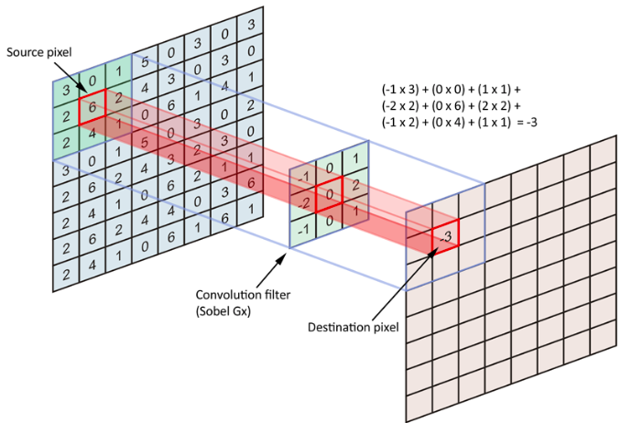
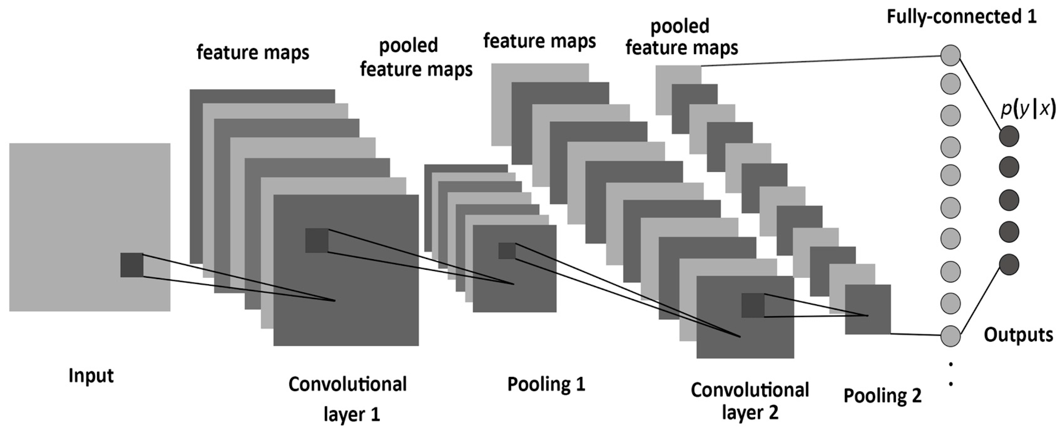
CNN - convolutional neural network

Slide 19
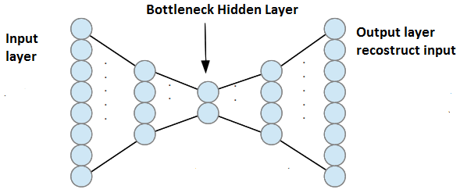

Slide 20
Writing Code
>>> from sklearn import svm
>>> X = [[0, 0], [1, 1]]
>>> y = [0, 1]
>>> clf = svm.SVC()
>>> clf.fit(X, y)
SVC(C=1.0, cache_size=200, class_weight=None, coef0=0.0,
decision_function_shape='ovr', degree=3, gamma='auto', kernel='rbf',
max_iter=-1, probability=False, random_state=None, shrinking=True,
tol=0.001, verbose=False)
>>> clf.predict([[2., 2.]])
array([1])

Slide 21
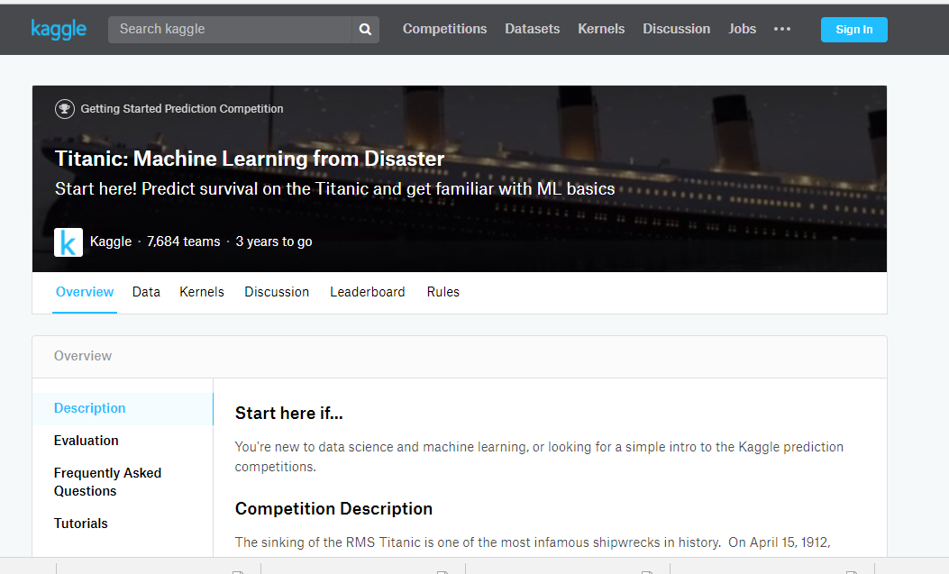
https://www.kaggle.com/c/titanic

Slide 22
What Do we Supply?
Hire experts for machine learning projects
Interview candidates from our machine learning expert graduates
Good Luck

