Slide 1

ניהול פרוייקטים
בסביבה רב פרוייקטלית
CI

Slide 2
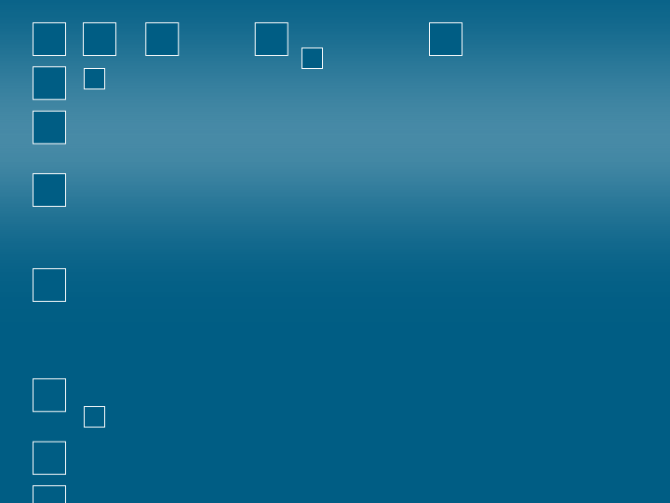
Constraint Innovation - CI
חדשנות ע"י ניהול אילוצים
בסביבה פרויקטאלית
מבוסס על תורת האילוצים - TOC
Lewis Trigger

Slide 3

תוכן
פרק 1:
  פתיחה: דילמות ניהוליות בסביבה רב פרויקטאליות
  פרק 2:
  תזמון וסנכרון פרויקטים בסביבה רב פרויקטאלית דינאמית
  פרק 3 :
  גישת "השרשרת הקריטית"
פרק 4:
  ניהול צווארי בקבוק ואילוצים בסביבה רב פרויקטאלית.

Slide 4
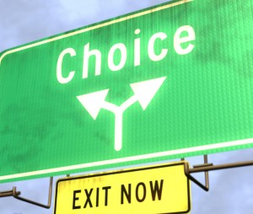
פרק 1
פתיחה
  דילמות ניהוליות
  בסביבה רב פרויקטאליות

Slide 5
להגדיר את "המערכת"
גבולות
תוכן
ממשכים

Slide 6

המערכת -
תפיסה תהליכית
תשומות
עבודה
תפוקות
מערכת "ריצפת ייצור" של מנהל הפרויקט
"חומר גלם"
אישור משימות הפרויקט
"מלאי בתהליך"
חבילות עבודה – תכנון / בקרה / שליטה
מחזק את מטרת הארגון: רווחיות
Notes:
TOC is generally seen as applying to Production & R&D. Need to take a wider view of the whole system:
Commercial Private Organization: The “Input” i.e. Raw Materials are the “Prospects / Opportunities” (from an advantage or in response to a threat ); WIP are the assignments that are worked on to turn the Raw Material into sustainable growing Profit that is translated into very tangible outputs; the same view also for public sector.

Slide 7
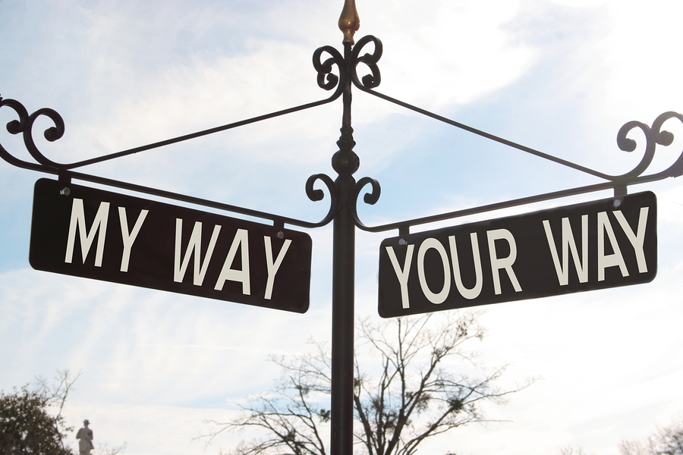
ToC Thinking Process
Verbalize a management conflict so as to find a creative solution

Slide 8



Project Management Conflict
Do whatever it takes to meet the “endangered” commitment
Compensate for early under estimation / misconsideration
(add safety buffers)
Meet original commitments
Don’t jeopardize any “formal” commitment
Don’t compensate for early under estimation / misconsideration
Notes:
This dilemma is clearly seen when we bid for a project contract – the top mang’t can’t risk putting in safety buffers as will endanger the chances of them winning the bid. However from the perspective of the Project Mngr & his team leaders they have to put in safety buffers in order to be able to stand by their task commitments.
The reason why we focus on the Schedule is our assumption that most of our comprimises on content and budget stem from the pressure to meet due date performance (i.e. don’t do this part of the project because we don’t have the time; or the concern of not finishing on time results in having to increase budget ). The reason that this assumption is so important is that what it means is that if we can solve the problem of meeting the due date than we can solve the problem of the other two concerns; namely content and budget.
Critical Chain Project Management (CCPM) brings most multi-project environments to high due date performance without comprimising content or budget. Instead of dealing with 3 things we now just deal with one. CCPM launched in the market pace in 1996. Literally thousands of Co’s have benefited from this – The Japanese Ministry of Infra structure has ruled in 2005 – Japan is constantly having to rebuild – an Industry that employs over 6 million people

Slide 9


הקונפליקט הטבוע במערכי "תפעול"
סביבה רב פרויטאלית
מאבק תמידי לצמצום הבזבוז
צריכים למדוד לפי יעילות EFFICIENCY
להיות מנהל טוב
אל תשתמש ב"יעילות" להגברת הזרימה
מאבק תמידי להגברת התפוקה – כמה שיותר בפחות זמן
Notes:
The efficiency conflict – break up large batches so as to work on other types of jobs that require priority (the large batch is efficient but it slows down throughput). Also for service industry – e.g. committees batch request so as to be efficient but it slows the throughput of a request through the system.
IAF – The Depot performance measurement of performing according to the “standard time” of SRU’s & LRU’s. This KPI damages the “throughput” as the workers aren’t necessarily maintaining what is most required in the field but rather what is easier to maintain in relation to the KPI “standard time”.
Amdocs – something similar - # of test cases completed rather than focusing first on those that add the highest added value to the Co.’ Same for # of defects found. Don’t push this as a fact but rather as a point for thought – still a tender issue.

Slide 10
פרק 2
  תזמון וסנכרון פרויקטים בסביבה רב פרויקטאלית דינאמית

Slide 11





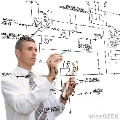


40 Gamma
30 Beta
60 Alpha
2
3
4
4
1
5
5
3
3
2
10
3
D
C
B
A

Slide 12
40 Gamma
30 Beta
60 Alpha
2
3
4
4
1
5
5
3
3
2
10
3
D200
C200
B200
A200

Slide 13
מה מקשה עלנו עוד יותר בהשגת יעדים?
בסביבת פרויקט בודד: אי וודאות מרפי
+
בסביבה רב פרויקטאלית: Bad Multi-tasking

Slide 14
“Bad” Multi Tasking
Assignments
ביצוע של כל משימה היא יחידה 1 של זמן נטו
A
B
TTM (Time to Market)
מתארך
C
D
E
F
t
1
2
3
4
5
6
Notes:
How do we get into a situation of “bad “ multi tasking to start of with? One of the reasons that we asked for extra time is that we explain that often we are dependent on other resources being available to do an activity that we need its output. Let’s say that we ask for 2 months even though the net time is one month. We “open a time vacuum”; and where there is a vacum it becomes filled; more filled than is consistent to the time space we allowed. Our “super” says OK, but then will come back to us with other assignments so that “G-d forbid” we aren’t wasting time.
Add to that the Multi Project environment – this is the real killer. Other functions in our organization come to us and push assignments onto us since we maybe waiting in any event. Once assignments have been given to me then pressure is applied so as to at least work on these assignments. Pressure is being applied by different customers, internal or external, to show that we are making progress by making sure that we are at least working on the assignments hence we end up jumping from one assignment to the other.
Need to distinguish between how much time it takes to complete a task and how much time we invest in a task. Using bad multitasking no one benefits. Remember the other task(s) in the project have to wait until this task is complete. This goes across the board in a multi project environment.

Slide 15
“Bad” Multi Tasking
+
Multiple Set Up Time
Assignments
A
B
TTM (Time to Market)
מתארך עוד יותר
C
D
E
F
t
1
2
3
4
5
6
Notes:
How do we get into a situation of “bad “ multi tasking to start of with? One of the reasons that we asked for extra time is that we explain that often we are dependent on other resources being available to do an activity that we need its output. Let’s say that we ask for 2 months even though the net time is one month. We “open a time vacuum”; and where there is a vacum it becomes filled; more filled than is consistent to the time space we allowed. Our “super” says OK, but then will come back to us with other assignments so that “G-d forbid” we aren’t wasting time.
Add to that the Multi Project environment – this is the real killer. Other functions in our organization come to us and push assignments onto us since we maybe waiting in any event. Once assignments have been given to me then pressure is applied so as to at least work on these assignments. Pressure is being applied by different customers, internal or external, to show that we are making progress by making sure that we are at least working on the assignments hence we end up jumping from one assignment to the other.
Need to distinguish between how much time it takes to complete a task and how much time we invest in a task. Using bad multitasking no one benefits. Remember the other task(s) in the project have to wait until this task is complete. This goes across the board in a multi project environment.

Slide 16
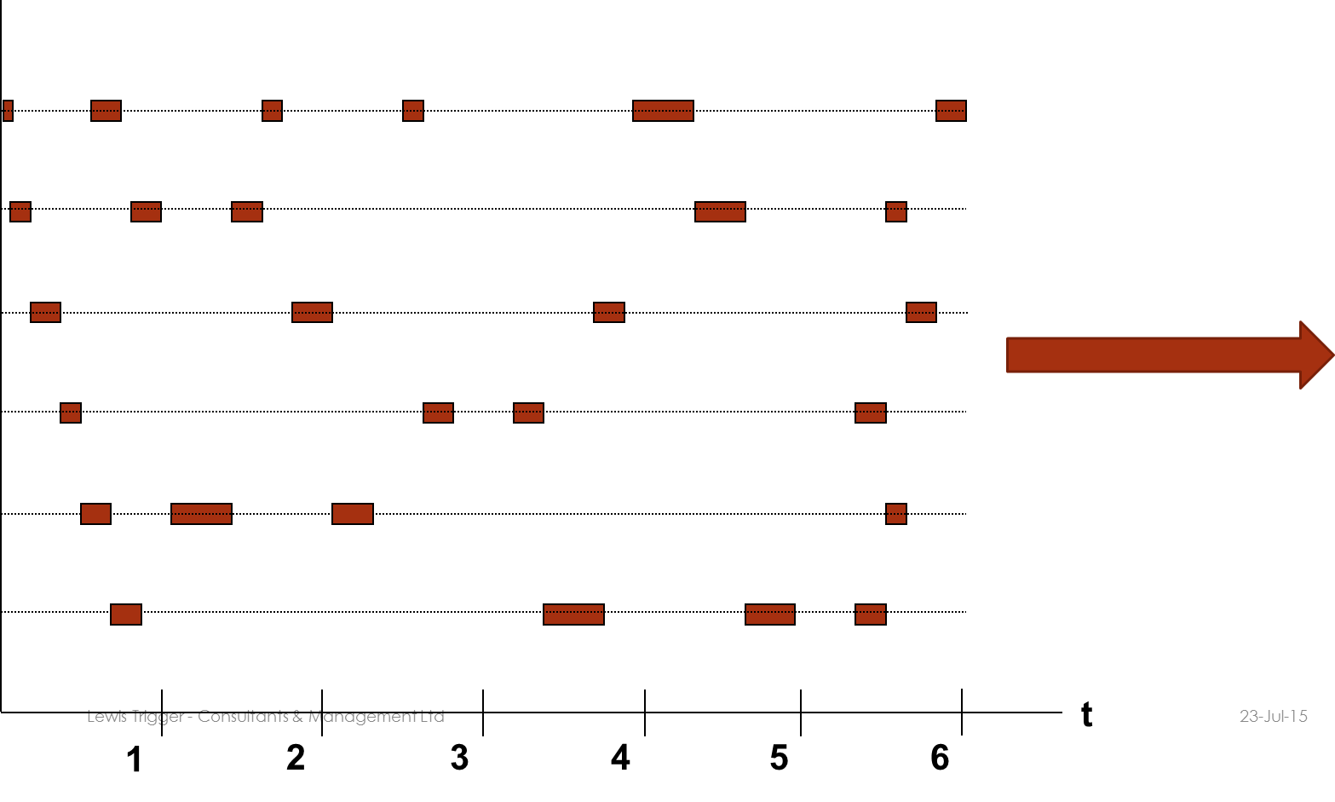
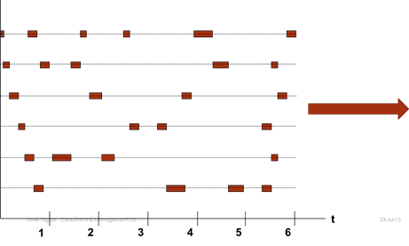
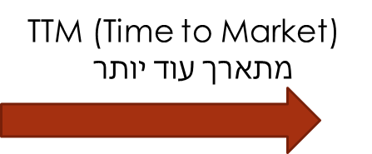
ה- Bad Multi-Tasking מתגלגל על הנתיבים של הפעילויות של הפרויקטים!!!
Notes:
What makes it worse is that we ask for extra time is that we explain that often we are dependent on other resources being available to do an activity that we need its output. Let’s say that we ask for 2 months even though the net time is one month. We “open a time vacuum”; and where there is a vacum it becomes filled; more filled than is consistent to the time space we allowed. Our “super” says OK, but then will come back to us with other assignments so that “G-d forbid” we aren’t wasting time.

Slide 17
תוצאות
אי עמידה בת"ע
עמידה בלו"ז דורשת תוספת משאבים (תקציב ) ו/או פגיעה במפרט.
הצטברות של "מלאי בתהליך" – כלומר משימות פתוחות.
התובנה היא, שהרצון להתחיל כל "הזמנה", כלומר פרויקט, כמה שיותר מוקדם לא בהכרח עוזר לנו לעמוד בתוכנית. ההפך, הוא יכול לפגוע בתוכנית עבודה.

Slide 18


פתרון Drum Buffer Rope
DBR
DRUM
Notes:
Solution is DBR
Organizations unfamiliar with TOC will claim that the Bottleneck is always moving. This impression comes about when traditional efficiency methods are used and we unnecessarily cause wandering pressure points on non constraints – allowing too much WIP on to the shop floor at one time; batching on non bottlenecks.
Size of the buffer – heuristic is half the “about” lead times used before DBR. More then enough protection. N.B. Before DBR most of the lead time is made up of WIP waiting in ques. Note that he is also answering the negative branch of it taking too long and it is too difficult to figure out how to calculate the buffer.
Who determines the buffer size - Under TOC this is a management decision – we understand what enormous ramifications this can have - both in terms of cost (WIP on the shop floor) as well as Throughput –(flow & quantity). Under traditional scheduling the fork lift driver decides.
Implemention:- Need to explain to all, including the workers. Negative branch is that according to the present culture, by ”starving” the non-bottlenecks there is a danger that the workers will interpret this as there not being enough work and they will think they are just before lay-offs.. The book “The Goal” is excellent, but unfortunately you can’t rely on people reading books. Use the film followed by discussion.
Setting priorities – another negative branch. Because of Murphy there will also be bottlenecks on non constraints from time to time. We set priorities according to the priorities for the constraint. If we have an internal constraint then we also have in place a shipping buffer – here we set priorities for WIP on non constraints before the shipping buffer according to the priorities of the shipping buffer. We can also set priorities for supporting services – for e.g. the repair team of a work station; where there is a conflict on which machine to work on we need to ask what is the priority of the WIP that is to be done by either the internal buffer or shipping buffer.
Expedite - heuristic: what has not arrived before the buffer by one third of the buffer time, needs to be expedited. Alos a good way of determining what should be th e size of your buffer – the ideal size is 5% expediting; if you are doing more than that then this is a sign that the buffer is too small; if it is less than 5% then the buffer is too large.
Reviewing the buffer size: the buffer size may need to be changed over time. If I increase the capacity of my constraint, then non constraint resources have less ability to quickly replenish the buffer, hence I will need to add more protection for the constraint by increasing the buffer if I have not increased the capacity of the non constraints.
TQM & Lean Manufacturing: Excellent techniques, however they are not focused enough. Need to apply to the constraint, also to those operations that are cuasing you to expedite (do a pareto analysis of where WIP is being stuck and why).
We want to avoid changing all our procedures when we are in the process of implementing the 4’th step – in other words we want to keep the constraint as being the constraint, even though we have improved its capacity. This can be done if at the same time that we improve the constraints capacity, we also improve the capacity of critical non constraints who would have become constraints if we had not made this change of improving their capacity in parallel. Remember, by improving the performance of the system and you thereby create a new constraint (if you do not do what I have just stated), we then have to put in to place new practices to support the new constraint. This drives every one crazy. Again we can find out what are the candidates on non bottlenecks to be improved by looking at the buffer profile of WIP and seeing what WIP is not arriving in time to the last third section. We then go back and analyze what operations are responsible for this.

Slide 19

Creative Solution expose an incorrect assumption

Slide 20
הקונפליקט הטבוע במערכי "תפעול"
סביבה רב פרויטאלית
"המחדר"- משאב שעומד בטל הוא לא בהכרח בזבוז
מאבק תמידי לצמצום הבזבוז
צריכים למדוד לפי יעילות EFFICIENCY
להיות מנהל טוב
אל תשתמש ב"יעילות" להגברת הזרימה
מאבק תמידי להגברת התפוקה – כמה שיותר בפחות זמן
Notes:
The efficiency conflict – break up large batches so as to work on other types of jobs that require priority (the large batch is efficient but it slows down throughput). Also for service industry – e.g. committees batch request so as to be efficient but it slows the throughput of a request through the system.
IAF – The Depot performance measurement of performing according to the “standard time” of SRU’s & LRU’s. This KPI damages the “throughput” as the workers aren’t necessarily maintaining what is most required in the field but rather what is easier to maintain in relation to the KPI “standard time”.
Amdocs – something similar - # of test cases completed rather than focusing first on those that add the highest added value to the Co.’ Same for # of defects found. Don’t push this as a fact but rather as a point for thought – still a tender issue.

Slide 21
אפקטיבי
מועילות במקום יעילות
  "יעילות" – היחס בין תפוקות לתשומות ברמה מקומית. לעשות דבר נכון!!
  "מועילות" (אפקטיביות) – מעשים בארגון שמביאים אותו קרוב יותר למטרת הארגון.
  לעשות את הדבר הנכון!!
Notes:
Intuitive – for the most part i.e. “The Goal”. Elements of the Critical Chain aren’t although once explained are very logically

Slide 22

הפתרון
מאבק תמידי לצמצום הבזבוז
יש להשתמש ב"מועילות"
להיות מנהל טוב
אל תשתמש ב"יעילות" להגברת הזרימה
מאבק תמידי להגברת התפוקה – כמה שיותר בפחות זמן
Win-Win
היתרונות של 2 צרכים

Slide 23
להגדיר את המטרה

Slide 24

גוף מסחרי
להשביח את הערך / שיפור מתמיד
אין סופי קיום אילוץ
גוף לא מסחרי - – אותו לוגיקה
לשפר ביצועים בהגבלת המשאבים בראשותם
האילוץ הוא המנוף לשיפור
Notes:
“Constantly Improve” – if not then given competition you will not survive.
From the book The Goal, the Goal of the plant is to “make money”. What Goldratt means by making money is any action that after true variable expenses are taken into A/C makes a true positive contribution to making money.
DAFWA- The DAFWA enables a progressive, innovative and profitable agricultural and food sector that benefits WA.

Slide 25
המטרה?
און סופי
מפרט
₪ / $
לו"ז
25

Slide 26

יעד
שונה מהמטרה ניתן להשגה
תאריכי אספקה
מפרט / איכות
תקציב / משאבים
אם קיים קושי בהשגה קיום אילוץ
Notes:
From the book The Goal, the Goal of the plant is to “make money”. What Goldratt means by making money is any action that after true variable expenses are taken into A/C makes a true positive contribution to making money.
DAFWA- The DAFWA enables a progressive, innovative and profitable agricultural and food sector that benefits WA.

Slide 27
היעדים?
עמידה ב"משולש הקדוש"
מפרט
₪ / $
לו"ז

Slide 28
שלב 1
לזהות את האילוץ
ה- DRUM

Slide 29
60 Alpha
4
15
1
60
3
20
3
20
A

Slide 30
60 Alpha
4
15
35
1
60
60
20
3
20
3
3
20
20
B
A

Slide 31
30 Beta
60 Alpha
4
15
3
35
38
1
60
60
60
5
20
3
20
30
3
10
3
20
20
26
C
B
A

Slide 32
40 Gamma
30 Beta
60 Alpha
2
15
3
4
35
38
46
4
1
60
60
60
70
5
5
20
3
20
30
50
3
2
10
20
3
20
26
46
D
C
B
A

Slide 33
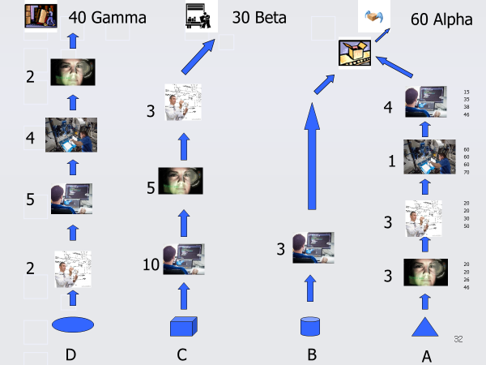
אילוץ המערכתי
בסביבה רב פרויקטאלית
"ההרבי" המערכתי

Slide 34
שלב 2
לנצל את האילוץ
ה- BUFFER

Slide 35
יש לוודא שאנחנו לא מבזבזים את האילוץ – מצב של 100% ניצול/שימוש מועיל של האילוץ.
“An hour wasted by the constraint is an hour wasted by the System as a whole !!! “
Jonah
Notes:
דבר מאוד בסיסי אם יש בזבוז של זמן אצל האילוץ.
Use the Pareto principle to see what % of the constraint’s time is being wasted or not effective and the reasons for that. E.g. ASC’s destroyer program, time is wasted on getting to and coming back from the eating facilities. They set up the eating facilities next to the constraint.

Slide 36
המשך שלב 2 – ניצול האילוץ
צעדים מעשיים:
שתמיד יהיה "חומר" נכון לעבוד עליו.
לשים מחסנית של "מלא התהליך" לפני האילוץ לפי סדר נכון.
Notes:
Strategic gating is therefore a screening procedure that enables the bottleneck to work most effectively on products that will increase the firm's value. Strategic gating brings about effective utilization of the constraint by giving priority to the most profitable jobs, which is done by using specific contribution measures, amongst other things (see Chapter 11). Strategic gating in a downtown supermarket, where shelf space is the bottleneck, is the decision regarding the products that are to be displayed on the shelves, when there are more than 150,000 Stock Keeping Units (SKUs) available and place for only 15,000 of them.

Slide 37
ניהול המלאי – לשרת את הצוואר בקבוק פנימי או שוק בתור אילוצים
ללחם נגד מרפי
8-
B
5pcs
3hrs
D
2pcs
6hrs
C
5pcs
5hrs
שחרר משימות מוקדם יותר לפני האילוץ !!
4-
A
25pcs
5hrs
B
5pcs
3hrs
C
2pcs
2hrs
Time Buffer

Slide 38

60 Alpha
4
15
1
60
3
20
3
20
A

Slide 39
60 Alpha
4
15
35
1
60
60
20
3
20
3
3
20
20
B
A

Slide 40
30 Beta
60 Alpha
4
15
3
35
38
1
60
60
60
5
20
3
20
30
3
10
3
20
20
26
C
B
A

Slide 41
40 Gamma
30 Beta
60 Alpha
2
15
3
4
35
38
46
4
1
60
60
60
70
5
5
20
3
20
30
50
3
2
10
20
3
20
26
46
D
C
B
A

Slide 42

המשך שלב 2 – ניצול האילוץ
לא "מבזבזים" את האילוץ
"מחסנית" של משימות לפני האילוץ לפי סדר נכון.
קביעת סדר עדיפויות בין המשימות :- Gating אסטרטגי - תעדוף משימות שמוסיפות את הערך הגבוה ביותר.
Notes:
Strategic gating is therefore a screening procedure that enables the bottleneck to work most effectively on products that will increase the firm's value. Strategic gating brings about effective utilization of the constraint by giving priority to the most profitable jobs, which is done by using specific contribution measures, amongst other things (see Chapter 11). Strategic gating in a downtown supermarket, where shelf space is the bottleneck, is the decision regarding the products that are to be displayed on the shelves, when there are more than 150,000 Stock Keeping Units (SKUs) available and place for only 15,000 of them.

Slide 43
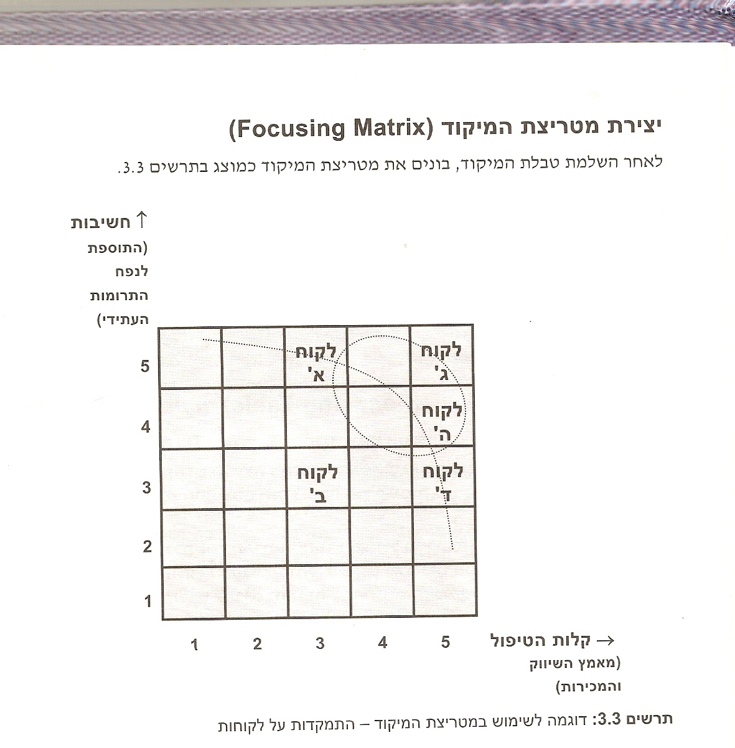
מטריצת מיקוד
  בחירה בין משימות שונות
  כלי עזר בתהליך של רידוד מפרטים בתהליכי פיתוח
וצאי דופן- בחירה בנושא שהוא קשה לטיפול אך תועלתו גדולה מאוד. או, נושא שהוא קל מאוד לטיפול, אך תרומתו קטנה כדי להוכיח תוצאות בשטח.
מישימות יחסית קלות חשובות ודחופות
VN65752
ג'
א'
'ד'
ה'
ב'

Slide 44
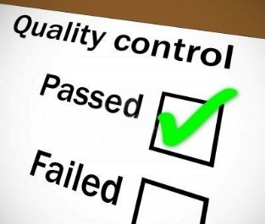
שלב 2 – ניצול האילוץ
צעדים מעשיים:
יש למנוע מהאילוץ מלעבוד על עבודה פגומה.
QC (ביקרת איכות)ו-QA (אבטחת איכות) לפני האילוץ.
סקרי תיכון (Design Reviews) כאבני דרך על הנתיב הקריטי
  פורמט של ה-DR הוא ביטוי ל-QA
  הביצוע של ה-DR הוא ביטוי ל-QC
ניהול תצורה (Configuration Management)
  התהליך של ה- ECO ו-ECR הוא ביטוי ל-QA
  הביצוע של ה- ECO ו-ECR הוא ביטוי ל-QC
Notes:
Min’ Kit – Amdocs is making sure that you have “Closed” the project scope with the customer.
Amdocs – Detailed Design Review

Slide 45
שלב 3
להכפיף לאילוץ
ה- ROPE

Slide 46
על מנת להפיק את המרב מהמערכת, כל המשאבים שאינם אילוץ צריכים:
לשרת את האילוץ
לא להפריע לאילוץ

Slide 47
60 Alpha
4
15
1
60
3
20
3
20
A

Slide 48
60 Alpha
4
15
35
1
60
60
20
3
20
3
3
20
20
B
A

Slide 49
30 Beta
60 Alpha
4
15
3
35
38
1
60
60
60
5
20
3
20
30
3
10
3
20
20
26
C
B
A

Slide 50
40 Gamma
30 Beta
60 Alpha
2
15
3
4
35
38
46
4
1
60
60
60
70
5
5
20
3
20
30
50
3
2
10
20
3
20
26
46
D
C
B
A

Slide 51
פתרון Drum Buffer Rope
DBR
DRUM
Notes:
Solution is DBR
Organizations unfamiliar with TOC will claim that the Bottleneck is always moving. This impression comes about when traditional efficiency methods are used and we unnecessarily cause wandering pressure points on non constraints – allowing too much WIP on to the shop floor at one time; batching on non bottlenecks.
Size of the buffer – heuristic is half the “about” lead times used before DBR. More then enough protection. N.B. Before DBR most of the lead time is made up of WIP waiting in ques. Note that he is also answering the negative branch of it taking too long and it is too difficult to figure out how to calculate the buffer.
Who determines the buffer size - Under TOC this is a management decision – we understand what enormous ramifications this can have - both in terms of cost (WIP on the shop floor) as well as Throughput –(flow & quantity). Under traditional scheduling the fork lift driver decides.
Implemention:- Need to explain to all, including the workers. Negative branch is that according to the present culture, by ”starving” the non-bottlenecks there is a danger that the workers will interpret this as there not being enough work and they will think they are just before lay-offs.. The book “The Goal” is excellent, but unfortunately you can’t rely on people reading books. Use the film followed by discussion.
Setting priorities – another negative branch. Because of Murphy there will also be bottlenecks on non constraints from time to time. We set priorities according to the priorities for the constraint. If we have an internal constraint then we also have in place a shipping buffer – here we set priorities for WIP on non constraints before the shipping buffer according to the priorities of the shipping buffer. We can also set priorities for supporting services – for e.g. the repair team of a work station; where there is a conflict on which machine to work on we need to ask what is the priority of the WIP that is to be done by either the internal buffer or shipping buffer.
Expedite - heuristic: what has not arrived before the buffer by one third of the buffer time, needs to be expedited. Alos a good way of determining what should be th e size of your buffer – the ideal size is 5% expediting; if you are doing more than that then this is a sign that the buffer is too small; if it is less than 5% then the buffer is too large.
Reviewing the buffer size: the buffer size may need to be changed over time. If I increase the capacity of my constraint, then non constraint resources have less ability to quickly replenish the buffer, hence I will need to add more protection for the constraint by increasing the buffer if I have not increased the capacity of the non constraints.
TQM & Lean Manufacturing: Excellent techniques, however they are not focused enough. Need to apply to the constraint, also to those operations that are cuasing you to expedite (do a pareto analysis of where WIP is being stuck and why).
We want to avoid changing all our procedures when we are in the process of implementing the 4’th step – in other words we want to keep the constraint as being the constraint, even though we have improved its capacity. This can be done if at the same time that we improve the constraints capacity, we also improve the capacity of critical non constraints who would have become constraints if we had not made this change of improving their capacity in parallel. Remember, by improving the performance of the system and you thereby create a new constraint (if you do not do what I have just stated), we then have to put in to place new practices to support the new constraint. This drives every one crazy. Again we can find out what are the candidates on non bottlenecks to be improved by looking at the buffer profile of WIP and seeing what WIP is not arriving in time to the last third section. We then go back and analyze what operations are responsible for this.

Slide 52

אסור לבזבז את התפוקה של האילוץ!
MARKET
Assembly
CCR
Constraint
BUFFER
Shipping
BUFFER
Assembly
BUFFER
ROPE
ROPE

Slide 53

3’rd step
Subordinate Mechanism
Identify
Exploit
“Choke” & “Release”
material i.e. Projects on to the “Shop floor” in line with the BUFFER consumption by the constraint.
Subordinate
Tactical
Issues
Strategic
Issues
CONSTRAINT
ROPE
BUFFER
Do not release material i.e. Project work packages in order to supply work to employees.
Notes:
Explain that we are using the analogy of a production floor – stress that we are only using it as an analogy, but a good analogy. Typically for an environment that has a high frequency of new & upgraded products, the drum is R&D.
Amdocs : Implementation principles adopted – Reduce WIP. They use the gating concept.
By reducing the amount of WIP on the “shop floor” it also allows us prepare a “Kit” properly for the waiting assignments – gives us all the advantages of having a kit prepared.

Slide 54
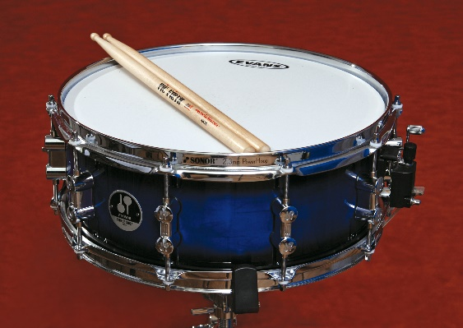
קושי בקביעת האילוץ המערכתי
"כלל אצבע":
להוריד 25% מה- WIP (פרויקטים בצנור)
כניסת פרוייקט חדש ל WIP במקום פרוייקט אחר (סיום או הקפאה)

Slide 55
“Focused” Tasking
Assignments
1 t
A
+
2 t
B
Increased Productivity because of reduced
Set -Ups
3 t
C
4 t
D
5 t
E
6 t
F
t
1
2
3
4
5
6
Notes:
Eg’ of avoiding bad multi tasking. Eli Goldratt tells the story of the F16 Falcon Up project in the mid 1990’s. Yud Aleph Aleph – Yechedat Handassa was the most loaded resource- Each of the engineers had any where in the vicinity of 50 tasks at the same time, and the average lead time on each task was 135 days (that is all the tasks in the yichida). How did we such large #’s of bad multi-tasking and LT – the engineer would go to one of the work-shops or lines to do a related task and invariably he was told that they are busy; so he would go back to his office to work on another problem; as this scenerio repeated itself more problems were opened up and assigned to engineers. Tried pushing as hard as they could with over time. The solution was to limit the engineers to not working on any more then 3 task at any one time; this was enforced even to the extent of being counter intuitive; in other words when an engineer would come and ask for a related task to be done so that he can make progress and he was told that there was no time then he would wait, and after an hour or a few hours there was time. By the end of one month the average LT for ALL tasks (including waiting time for those that hadn’t been assigned) went down to less then 30 days and there was no overtime. Set up times also went down drastically which also accounted for drop of time actually invested hence the engineerrs were able to do more in fact. These figures have been released to public domain – see the Goldratt tapes.
Exercise to show the effect of lost throughput and damaging quality (mistakes, rework) via BMT - you have to consecutively write down the #’s 1,2,3,4,5,6,7,8,9,10 and immediately after that write down the letters of “MULTITASK”. After that you are asked to do MT – write a # followed by a letter from the word “MULTITASKING” i.e. 1M2U3L4T5I6T7A8S9K10. Ask the participants how much longer it took and if there were mistakes, some not founf and others found that need to be reworked.
Why is it that between 25% and 50% of people report feeling overwhelmed or burned out at work?
It's not just the number of hours we're working, but also the fact that we spend too many continuous hours juggling too many things at the same time.
What we've lost, above all, are stopping points, finish lines and boundaries. Technology has blurred them beyond recognition. Wherever we go, our work follows us, on our digital devices, ever insistent and intrusive. It's like an itch we can't resist scratching, even though scratching invariably makes it worse.
Tell the truth: Do you answer email during conference calls (and sometimes even during calls with one other person)? Do you bring your laptop to meetings and then pretend you're taking notes while you surf the net? Do you eat lunch at your desk? Do you make calls while you're driving, and even send the occasional text, even though you know you shouldn't?
The biggest cost — assuming you don't crash — is to your productivity. In part, that's a simple consequence of splitting your attention, so that you're partially engaged in multiple activities but rarely fully engaged in any one. In part, it's because when you switch away from a primary task to do something else, you're increasing the time it takes to finish that task by an average of 25 per cent.
But most insidiously, it's because if you're always doing something, you're relentlessly burning down your available reservoir of energy over the course of every day, so you have less available with every passing hour.
I know this from my own experience. I get two to three times as much writing accomplished when I focus without interruption for a designated period of time and then take a real break, away from my desk. The best way for an organization to fuel higher productivity and more innovative thinking is to strongly encourage finite periods of absorbed focus, as well as shorter periods of real renewal.
If you're a manager, here are three policies worth promoting:
1. Maintain meeting discipline. Schedule meetings for 45 minutes, rather than an hour or longer, so participants can stay focused, take time afterward to reflect on what's been discussed, and recover before the next obligation. Start all meetings at a precise time, end at a precise time, and insist that all digital devices be turned off throughout the meeting.
2. Stop demanding or expecting instant responsiveness at every moment of the day. It forces your people into reactive mode, fractures their attention, and makes it difficult for them to sustain attention on their priorities. Let them turn off their email at certain times. If it's urgent, you can call them — but that won't happen very often.
3. Encourage renewal. Create at least one time during the day when you encourage your people to stop working and take a break. Offer a midafternoon class in yoga, or meditation, organize a group walk or workout, or consider creating a renewal room where people can relax, or take a nap.
It's also up to individuals to set their own boundaries. Consider these three behaviors for yourself:
1. Do the most important thing first in the morning, preferably without interruption, for 60 to 90 minutes, with a clear start and stop time. If possible, work in a private space during this period, or with sound-reducing earphones. Finally, resist every impulse to distraction, knowing that you have a designated stopping point. The more absorbed you can get, the more productive you'll be. When you're done, take at least a few minutes to renew.
2. Establish regular, scheduled times to think more long term, creatively, or strategically. If you don't, you'll constantly succumb to the tyranny of the urgent. Also, find a different environment in which to do this activity — preferably one that's relaxed and conducive to open-ended thinking.
3. Take real and regular vacations. Real means that when you're off, you're truly disconnecting from work. Regular means several times a year if possible, even if some are only two or three days added to a weekend. The research strongly suggests that you'll be far healthier if you take all of your vacation time, and more productive overall.
A single principle lies at the heart of all these suggestions. When you're engaged at work, fully engage, for defined periods of time. When you're renewing, truly renew. Make waves. Stop living your life in the gray zone.
More blog posts by Tony Schwartz More on: Managing yourself, Personal effectiveness, Productivity

Slide 56
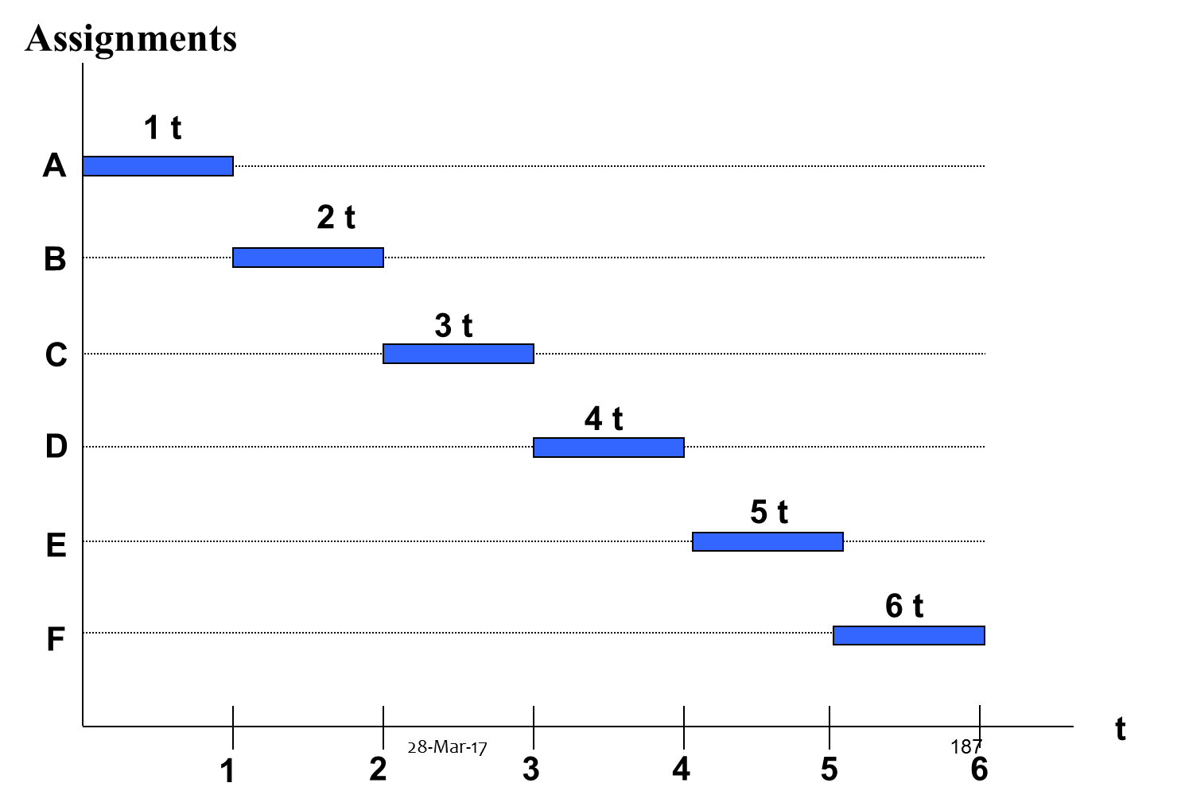

Reducing Bad Multi Tasking that is rolled out through the paths of the multi project environment
TTM (Time to Market)
reduced
+
Increased Productivity because of reduced Set -Ups

Slide 57

כיצד נוכל לסייע עוד לאילוץ?
שלב 4 – להקל על האילוץ
לשנות את "התכן" של האילוץ או
את המע' שתומכת באילוץ

Slide 58
שלב יותר קשה.
לבצע בסוך
צעדים להגדיל את הקיבולת של האילוץ
לקנות עוד קיבולת (עוד כ"א, ציוד, תשתית, שע' נוספות, מיקור חוץ..) – מותנה לניתוח עלות / תועלת.
שיפור תכן של האילוץ ו/או תהליכי עבודה של האילוץ
להוריד משימות מהאילוץ למשאבים אחרים Off Loading

Slide 59
40 Gamma
30 Beta
60 Alpha
2
15
3
4
35
38
46
4
1
60
60
60
70
5
5
20
3
20
30
50
3
2
10
20
3
20
26
46
D
C
B
A

Slide 60

ניהול האילוץ: 5 שלבים
זיהוי האילוץ
  צוואר הבקבוק
2. ניצול האילוץ
תעשו את הכול על מנת להוציא 100% מהאילוץ.
3. כפיפות משאבים אחרים
לשמור על ניצול האילוץ:- עדיפות לאילוץ; לא להפריע לאילוץ.
4. להקל על האילוץ
יוזמות על מנת להשיג יותר מ-100%.
5. לחזור לשלב הראשון בטיפול באילוץ הבא.
Notes:
Subordinate – “don’t allow non constraints to interrupt correct flow of throughput to the constraint” – meaning, by keeping the non constraints busy all the time so as to be efficient, what are the chances that a non bottleneck is working in time on WIP that will be needed by the constraint latter in time?
Important to realize – if you don’t look for the new constraint then you let inertia set in; which means allowing a set policy, formal or informal (the way we do business), to stay in place and this then becomes the new constraint as reality changes.
From the Herbie story – the Constraint becomes central part of the solution
– e.g. The first Cosmonaut story - launcing the first man into space. After a day or two there was this constant knocking sound. Tried to stop by finding the source. But he couldn’t find where it as coming from. He had another 25 days in space and he realized that this noise would cause him to loose his mind. So, he closed his mind and he took in this tapping noise and in his mind he turned it into the rhythm of music that he loved and he played in his head that music untill he landed back safely on earth.
- e.g. – A radio station in Perth. Like most radio stations it makes its money from advertisements. It was loosing a significant part of it advertisements to the internet marketing. What it did is that it embraced this obstacle, this constraint , and turned it into an advantage. It offered its sponsors to advertise on the radio their web site.

Slide 61
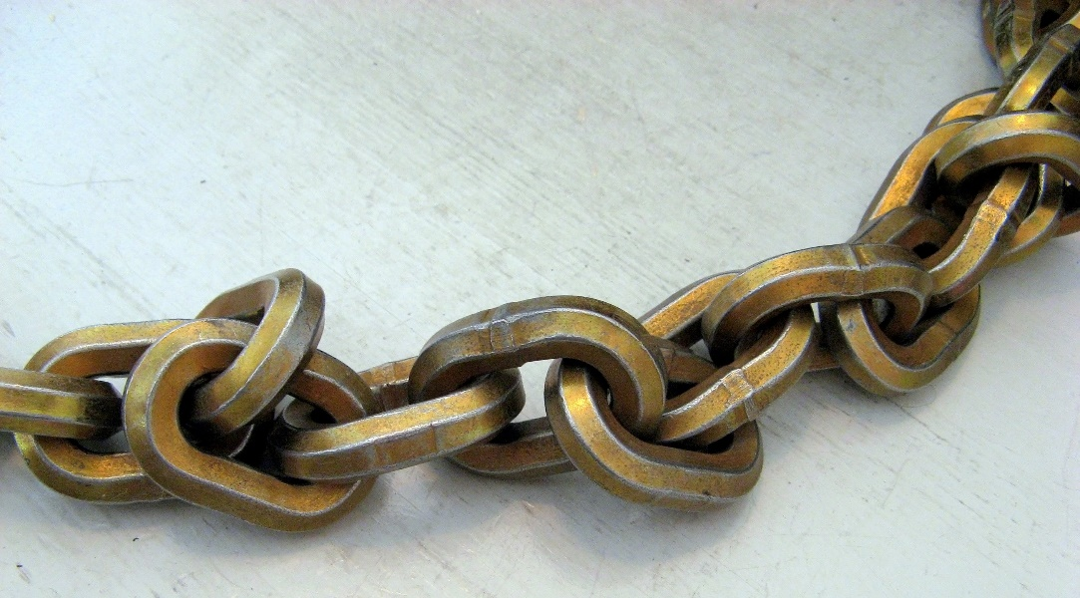
פרק 3
  גישת "שרשרת הקריטית"

Slide 62

מטודות לקיצור לו"ז בפרויקטים
דרך ניהול "השרשרת קריטית"
למה להתרכז בלו"ז?
TTM (Time to Market) - $$$
השפעה על העלות
השפעה על עמידה במפרט

Slide 63

Step 1: “Identify the Constraint”
Every Project has the Same Constraint
The Project’s Critical path
The “Classical” Critical Path
The longest path from all the paths calculated from the “Early Start” of each activity.
Based on a Task Dependency

Slide 64
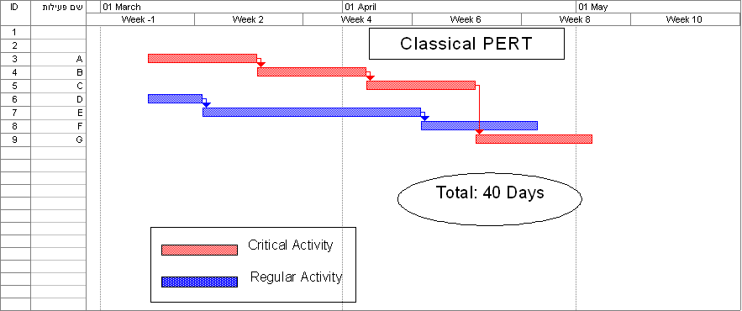
Example – F16 Retrofit
Recourses required:
1 Fire Control team
1 Cockpit
Recourses required:
1 Armament’s team
1 Cockpit

Slide 65
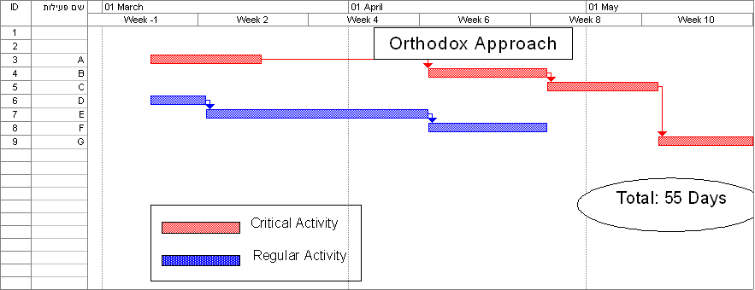
Cockpit not required
Typical
Whoever can use the cockpit first. Efficient

Slide 66
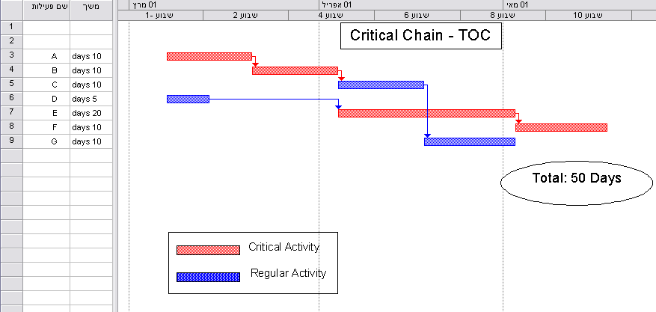
Effective v’s Efficient
Check for a Logistical Dependency:
“2 tasks or more that use the same resource yet there isn’t enough ..”
Heuristic: Give priority to the classical critical task
Correct Critical Path: Task dependency & Logistical dependency

Slide 67
Definition: “Critical Path”
The “Correct” Critical Path
The longest path from all the paths calculated from the “Early Start” of each activity
Based on Task Dependency
&
Logistical Dependency
ToC term: “Critical Chain”

Slide 68
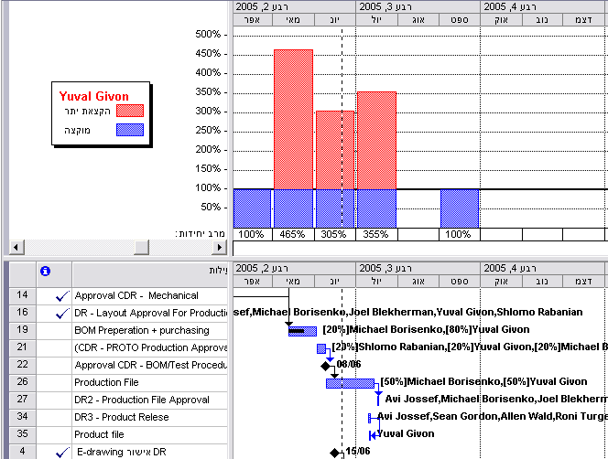
Using traditional tools i.e. MS Project
Reveal the Logistical Dependency
Use the CI heuristic to identify the correct critical path

Slide 69

Step 2: “Exploiting the Constraint”
The “Gee Whiz” of Critical Chan

Slide 70
ToC Thinking Process
Verbalize a management conflict so as to find a creative solution

Slide 71
Project Management Conflict
Do whatever it takes to meet the “endangered” commitment
Compensate for early under estimation / misconsideration
(add safety buffers)
Meet original commitments
Don’t jeopardize any “formal” commitment
Don’t compensate for early under estimation / misconsideration
Notes:
This dilemma is clearly seen when we bid for a project contract – the top mang’t can’t risk putting in safety buffers as will endanger the chances of them winning the bid. However from the perspective of the Project Mngr & his team leaders they have to put in safety buffers in order to be able to stand by their task commitments.
The reason why we focus on the Schedule is our assumption that most of our comprimises on content and budget stem from the pressure to meet due date performance (i.e. don’t do this part of the project because we don’t have the time; or the concern of not finishing on time results in having to increase budget ). The reason that this assumption is so important is that what it means is that if we can solve the problem of meeting the due date than we can solve the problem of the other two concerns; namely content and budget.
Critical Chain Project Management (CCPM) brings most multi-project environments to high due date performance without comprimising content or budget. Instead of dealing with 3 things we now just deal with one. CCPM launched in the market pace in 1996. Literally thousands of Co’s have benefited from this – The Japanese Ministry of Infra structure has ruled in 2005 – Japan is constantly having to rebuild – an Industry that employs over 6 million people

Slide 72
Creative Solution expose an incorrect assumption

Slide 73
Project Management Conflict
The safety that we have put in is not sufficient
Do whatever it takes to meet the “endangered” commitment
Compensate for early under estimation / misconsideration
(add safety buffers)
Meet original commitments
Don’t jeopardize any “formal” commitment
Don’t compensate for early under estimation / misconsideration
Notes:
This dilemma is clearly seen when we bid for a project contract – the top mang’t can’t risk putting in safety buffers as will endanger the chances of them winning the bid. However from the perspective of the Project Mngr & his team leaders they have to put in safety buffers in order to be able to stand by their task commitments.
The reason why we focus on the Schedule is our assumption that most of our comprimises on content and budget stem from the pressure to meet due date performance (i.e. don’t do this part of the project because we don’t have the time; or the concern of not finishing on time results in having to increase budget ). The reason that this assumption is so important is that what it means is that if we can solve the problem of meeting the due date than we can solve the problem of the other two concerns; namely content and budget.
Critical Chain Project Management (CCPM) brings most multi-project environments to high due date performance without comprimising content or budget. Instead of dealing with 3 things we now just deal with one. CCPM launched in the market pace in 1996. Literally thousands of Co’s have benefited from this – The Japanese Ministry of Infra structure has ruled in 2005 – Japan is constantly having to rebuild – an Industry that employs over 6 million people

Slide 74
The Probability Function of a Project / Non Routine
Activities

Slide 75
Probability of Completion Original Estimate
F(t)
Required Safety Buffer
Major Conflict
t
Unit Of Time
50%
Complete Activity
90%
1
3
9
Notes:
The more uncertainty in the environment the more skewed it is to the right.

Slide 76
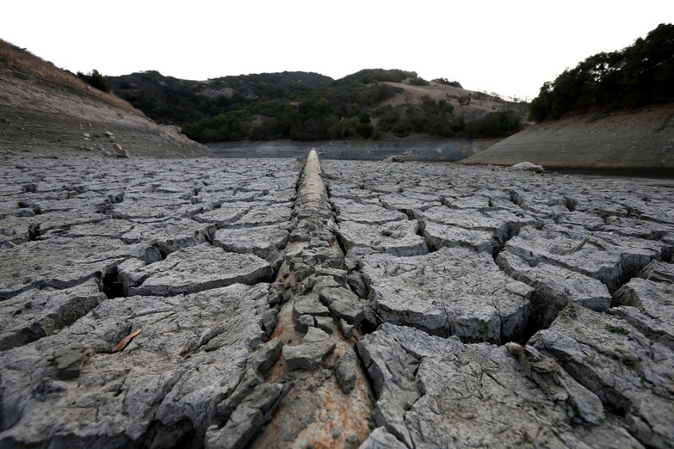
To make matters worse task safety buffers worsen the situation
Parkinson’s Law:
“Additional time given is filled”
Statistically
Delaying exposes the task to “Murphy”
Opportunities are wasted

Slide 77


The “Student Syndrome”
Not “allowing” oneself early completion after pressurizing to be given the safety time
Why finish earlier if the task after isn’t going to commence earlier?
“Manyana” – when there is a constant pile up of work why hurry up?

Slide 78

Cont’ - Why task safety buffers hurt?
The safety time opens a window of time that is “invites” bad Multi Tasking
Bad Multi Taking is
THE Assassin of success

Slide 79
“Bad” Multi Tasking
Each assignment is I unit of time
Assignments
A
B
TTM (Time to Market)
longer
C
D
E
F
t
1
2
3
4
5
6
Notes:
How do we get into a situation of “bad “ multi tasking to start of with? One of the reasons that we asked for extra time is that we explain that often we are dependent on other resources being available to do an activity that we need its output. Let’s say that we ask for 2 months even though the net time is one month. We “open a time vacuum”; and where there is a vacum it becomes filled; more filled than is consistent to the time space we allowed. Our “super” says OK, but then will come back to us with other assignments so that “G-d forbid” we aren’t wasting time.
Add to that the Multi Project environment – this is the real killer. Other functions in our organization come to us and push assignments onto us since we maybe waiting in any event. Once assignments have been given to me then pressure is applied so as to at least work on these assignments. Pressure is being applied by different customers, internal or external, to show that we are making progress by making sure that we are at least working on the assignments hence we end up jumping from one assignment to the other.
Need to distinguish between how much time it takes to complete a task and how much time we invest in a task. Using bad multitasking no one benefits. Remember the other task(s) in the project have to wait until this task is complete. This goes across the board in a multi project environment.

Slide 80
“Bad” Multi Tasking
+
Multiple Set Up Time
Assignments
A
B
TTM (Time to Market)
Takes even longer
C
D
E
F
t
1
2
3
4
5
6
Notes:
How do we get into a situation of “bad “ multi tasking to start of with? One of the reasons that we asked for extra time is that we explain that often we are dependent on other resources being available to do an activity that we need its output. Let’s say that we ask for 2 months even though the net time is one month. We “open a time vacuum”; and where there is a vacum it becomes filled; more filled than is consistent to the time space we allowed. Our “super” says OK, but then will come back to us with other assignments so that “G-d forbid” we aren’t wasting time.
Add to that the Multi Project environment – this is the real killer. Other functions in our organization come to us and push assignments onto us since we maybe waiting in any event. Once assignments have been given to me then pressure is applied so as to at least work on these assignments. Pressure is being applied by different customers, internal or external, to show that we are making progress by making sure that we are at least working on the assignments hence we end up jumping from one assignment to the other.
Need to distinguish between how much time it takes to complete a task and how much time we invest in a task. Using bad multitasking no one benefits. Remember the other task(s) in the project have to wait until this task is complete. This goes across the board in a multi project environment.

Slide 81
Probability of Completion: Shift in Reality
F(t)
התוצאה הסופית הינה שהסטיות הסטטיסטיות השליליות מצטברות והסטיות החיוביות מתבזבזות.
נוצרת מציאות חדשה. אנו פוגעים בעצמנו !
30%
30%
50%
90%
t
Complete Activity

Slide 82
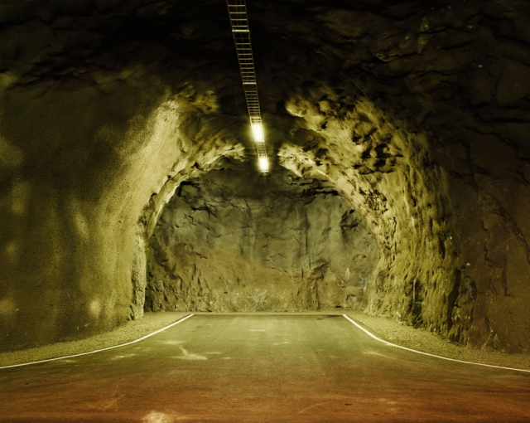
Dead End??

Slide 83
Exploit the Constraint
Step 2
Don’t waste the safety Buffers of the Critical tasks
Put in a PROJECT BUFFER
Higher probability of success with shorter project time
Notes:
There is a way of shortening the time even more; if we break up activity E so that it can start straight after D by going into the pilot’s cabin; when activity A is finished then E get;s out and allows B to go into the pilot cabin. We would be able to get to this improved solution by using the same logic of critical chain / path; – once we had identified the true critical path we then need to ask ourselves if we can do more to give preference to the critical path and we would have got to this solution.

Slide 84
The “half – half” heuristic
A
B
E
F
50% of the estimate
The 50% that was reduced goes to..
A
B
E
F
Project Buffer
Cut the Buffer in half, gives the same Statistical Protection..
A
B
E
F
Notes:
Let’s begin with the first step, namely halving the estimated times if the task that make up the Critical Chain. By halving a task’s estimated time, we have for the most part neutralized the negative effects of “Parkinson’s Law” that we elaborated on earlier. No longer will those that are executing a task fall into the “trap” of the “Student’s Syndrome” by exposing themselves to additional risk by leaving the completion of a task to the very “last moment”. At the same time if “good fortune” should come by, the task manager is more than happy to make use of such opportunities so as to allow him to complete the task within the reduced allocated time. The insight that Goldratt offers us is again based on a common sense understanding of human behaviour rather than producing empirical evidence.
The halving of the estimated times the Critical Chain tasks provides yet another advantage. Very simply put we can say that a new significantly reduced schedule has been developed. The fact that this is the new schedule, simply put means that if a task can complete the revised reduce time, then it will. Following on from this, the task that is to follow has been rescheduled to commence earlier as well and that task obviously will want to start in accordance to this schedule if it is in a position to do so. What we have just stated are additional variations of neutralizing the negative effects of what we wrote earlier in the section dealing with “Parkinson’s Law”.
By halving the original estimates of task times we have also countered the negative effects resulting from bad multi-tasking. The reader will recall from that section that in a multi-project environment where a person is assigned a task that has a significant safety buffer built in, then it stands to reason that such a person will be a readier candidate for having more assignments placed upon him concurrently, as opposed to a person who has been given an assignment with a very tight schedule. By halving the estimated completion time of a task, we have significantly reduced falling into the trap of bad multi-tasking. When additional tasks need to be assigned, common sense tells us that the more likely candidate to be assigned these tasks concurrently is the person who has extended time estimates because of the task buffers, as opposed to that person who has been assigned a task with a very tight schedule.
Eg’ of improved statistical performance by sharing a Co’ car; Central inventory.
PB concept works well on projects that don’t continue beyond a year & a half, otherwise the PB id too big. Hence what we do if a project is really long is to break it up to smaller projects.
With TOC we do not plan in milestones as fixed dates, otherwise we fall into the trap of Parkinson’s law & we end up exposing ourselves to Murphy as well as not being able to exploit opportunities of finishing early.

Slide 85
Cutting the original time in half the statistical ramifications
Notes:
We recognise that the heuristic of simply halving the time estimates is far from being a suitable solution. Yet at the same time, paradoxically it is will for the most part provide a better result in terms of shorter completion times with a higher probability, in comparison to the traditional method of adding safety buffers to the individual task. Remember what we wrote earlier on the section dealing with the traditional approach to safety buffers. There we elaborated on how the traditional approach leads to an even lower probability of a task being completed on time and that is with a safety buffer being built in.

Slide 86
Cutting the project safety buffer in half The statistical ramifications
Notes:
The crux of the solution of providing a very high probability (98% and above) of completing the project on time is the addition of the Project Safety Buffer. What we will elaborate on now is how the addition of the Project Safety Buffer is the key to achieving our desired result. By aggregating the safety buffer of each of the tasks on the Critical Chain I have created a Normal distribution function, providing that the number of tasks on the Critical Chain is a substantial number, in general above 30. We have just evoked the Central Limit Theorem of Statistics (Devore, 1987:213). Typically, the variance in a Normal distribution will be less than the variance of a Skewed Distribution. Remember that most of the tasks, if not nearly all the tasks in a project, will have a skewed variation. Simply put, less variation means less risk.
Add to this the Statistical rule of Aggregation. By creating a Project Buffer as well changing the performance measurement to a group performance rather than an individual task performance (elaborated on earlier), together with the methodology of how we engage the project team members in term of committing to a time (elaborated on earlier) we have aggregated the variances of the separate tasks. The aggregated variance will be significantly less than most of not all of the separate task variances.
As an analogy take the case of a central warehouse that supplies inventory to various outlying service centres. Statistically we will achieve a higher service level with less inventory than we would by dispersing the inventory to the various outlying service centres that cannot easily supplement one another in the event of decreasing stock levels.
The statistical rule states that the aggregated variance of several tasks that are independent and identically distributed is: $σ_{χ}$= $\frac{σ}{\sqrt{n}}$ (Devore, 1987:206).
For example the variability of 4 tasks of the same variability combined is half the variability of the individual task. If $n=4 tasks, σ is the variance of a task, and σ_{χ} is the aggreagted variance of the 4 tasks$
$then σ_{χ}$= $\frac{σ}{\sqrt{n}}$ = $\frac{σ}{\sqrt{4}}$ = $\frac{σ}{2}$ .
Since we are talking about 30 tasks or more making up a Critical Path, then clearly the variance of the “Critical Chain” of the entire project, that includes the project buffer, will be significantly less than most if not all of the variances of the individual tasks.
The Critical Chain including the Project Safety Buffer before it is halved provides nearly always a very high probability, above 99%, of the project being completed within the time that includes the Safety Buffer. A major insight of Goldratt is that by halving the Safety Buffer by half, we will NOT significantly reduce the probability of completing the project with the reduced time frame. Even though Goldratt himself doesn’t elaborate on the statistical explanation of this point, the writers of this paper have thought through the statistical reasoning. The statistical reasoning has to do with the shape of the probability distribution of the of project based on the logic of the Critical Chain. Remember what we stated earlier. Namely that the Safety Buffer that is made up of at least 30 tasks. What that means is that we have a normal distribution with a relative small variance in relation to the variances of the individual tasks that contributed to the project Safety Buffer. The meaning of a “small variation” is that the normal distribution is “squeezed” upward around its mean value. The further we increase outwards time estimate from the mean value, we will only achieve a reducing marginal improvement in the probability of successfully completing the time. The very opposite was the case for the individual tasks. Because of the skewed probability distribution of the individual tasks, it was necessary to significantly increase the time estimate in order to have a higher probability of success of completing the task on time. Earlier in this paper we talked about having to multiply the mean time by 3 to 4 times its value in order to achieve a high probability. But in the case of the Project based on the logic of the Critical Chain with a Project Safety Buffer, we no longer need those extended times. We can easily halve the aggregated times estimate of the Project Buffer by half without having any significant reduction of the probability of succeeding in completing the project.
In accordance with good “good project management” techniques, the maximum number of tasks in a project will be between 300 to 350. Typically, about a third make up the Critical Path. What that means is that normally even for a very complex project, the number of tasks that contribute to the Project Safety Buffer will be in the vicinity of a 100 tasks

Slide 87


Challenges to Implementation
Team member abusing the Project Buffer
  Answer is a Team KPI rather than an Individual KP
    Team KPI – team “reward & punishment”
Senior Management “mishandling” of the Project Buffer
  Answer – educating Senior management as to the necessity of building in the Project Buffer
Notes:
Changing behavior by having appropriate KPI’s. An excellent analogy can be made to a soccer team. Rather than award each player according to the amount of goal he achieves, the team will reach better performance if the team members are rewarded collectively on the # of goals achieved. By having a collective measurement you encourage far more team work in achieving goals. Players now have an incentive to assist one another in setting up goals for one another.

Slide 88
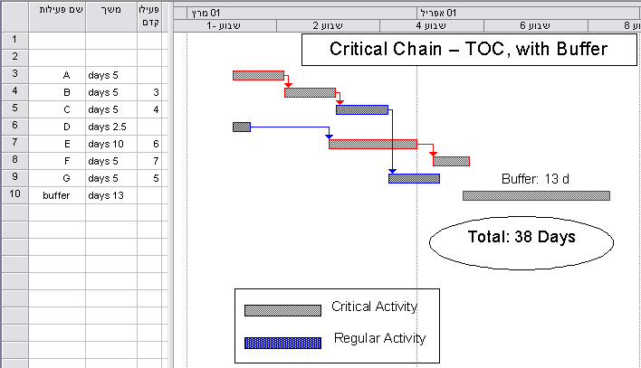
Example – F16 Retrofit
Notes:
The 3’rd step of TOC – “Subordinate to the Constraint” – Need to subordinate all Decisions to the Constraint. The way that this is translated is by having “Feeding Buffers” and “Resource buffers”. Feeding buffers need also to be applied on the END of those paths that are non critical and join up directly to the End Node as depicted in the CPM methodology. Resource buffers are only placed where a resource is required to be ready for the critical path. Note an interesting effect that sometimes occurs with feeding buffers – as the critical path buffer is “eaten up” and tasks on the critical path are consequently delayed, we find that often the feeding paths become enlarged.
The TOC steps: 1.- Arrange all the tasks according to LS without taking into account resource constraints (i.e. what TOC calls the “logistics” dependency). 2. Calculate the Critical Path - this represents the shortest time to complete the project if we ignore the “logistics” dependency and only figure in the precedence relationship. 3. The critical path is the basis for developing the Critical Chain. Now take into consideration the resource constraint and do Resource Leveling by moving all the tasks that are not on the critical path. Note that this is the basic heuristic employed by TOC as to choosing the critical path. By the way you can determine of there are more Logical Limitations or Logistical Limitations according to the path of the critical chain, according to how the continuity was determined. 4. Put in the Feeding buffers. 5. Put in the Resource Buffers.

Slide 89
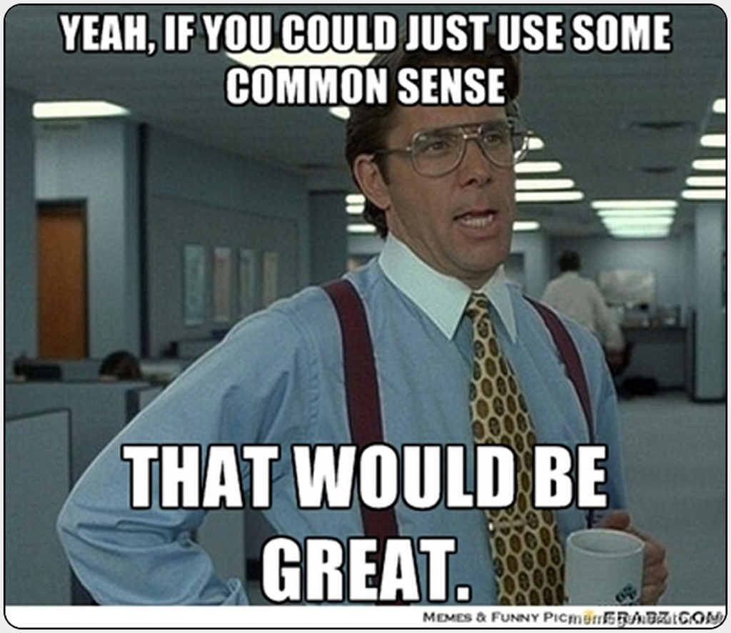
Applying the “Half – Half” Rule
Use Common Sense

Slide 90
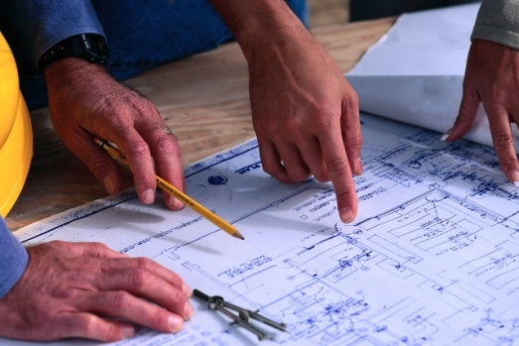
Defining Task Times
Challenge planned start times change with project performance
Turn this challenge into an Opportunity
Emphasis on the task’s Lead Time rather than the start date &/or finish time.
Need to give sufficient warning as the actual date required becomes more certain. – not too far; not too close
For in house team apply the “half – half” rule.
The PM needs to ensure that a minimum “kit” is in place for the task team.

Slide 91

Defining Task Times
For Vendors & Contractors
Same principles as the in –house team, without the “half –half’ rule.
The negotiations need to emphasis LT as much as price.
Difficult to include in the contract the principles afforded by the PB. Instead the PM needs to “encourage” the contractors performance with a heavy penalty clause and the option of a bonus.
Notes:
With vendors and contractors the emphasis in negotiation should not be only on ”price” , equally important, if not more important if we take in to consideration TTM, is lead time. Vendor will be more responsive to a shorter lead time if he is given sufficient warning. On the other hand too far advance will encourage him to add lead times as the further out in time he has to commit himself the more uncertainly is involved, hence bigger safety buffers.
Note that we may have a case where we already have an existing contract with a contractor where due dates have been determined. Concerto is very flexible. You can put in a due date called a “contractual milestone”. Generally these will not be on the “critical chain”. If you need to feed it then you can treat it as a mini project with its own buffer before it hence you can build your own buffer before it ; & / or there will be a feeding buffer after it.

Slide 92
Subordinate
Step3
Subordinate the non constraints to the Constraint
Tasks, paths, resources are made available to support the Critical Path.
Feeding Buffers
&
Resource Buffer

Slide 93
Feeding Buffer (FB)
Scenario “A”
Aim: Protecting the Starting Time on activities in the critical chain that have a logical dependency on a non critical feeding activities.
Critical Chain
Non Critical Path
FB
Use the “half – half” rule
Delaying ES.
Time

Slide 94
Feeding Buffer (FB)
Scenario “B”
Aim: Protecting the FINISHING Time of the critical chain that have a logical dependency on non critical feeding activities.
פעילות על שרשרת קריטית
PB
Finish
Critical Chain
Non Critical Path
FB
Use the “half – half” rule
Time

Slide 95
Resource Buffer (RB)
Aim: To ensure that a critical chain activity is not held up to start on time or before its originally scheduled time (positive variation) because of the lack of a “constraint” resource.
A new resource on the Critical Path
A new resource on the Critical Path
RB
RB
Critical Chain Activity
Critical Chain Activity
Time
Notes:
We are talking about having a “full kit” before. Extremely difficult for management to accept since it is percieved as being a waste. Need to consider the financial consequence of NOT having a resource there available when it is needed (including allowing us to start earlier because of a positive variation). Generally I would be more reluctant to fork out money on the “maybe” at the beginning of the project; if there are negative variations then I will allow the PB to absorb it. As the project progresses I would use the RB concept depending on how my PB looks. Also I would prefer to finalize a contract on a RB after I get closer to the time since it is likely that the timing of activities change as we progress .

Slide 96
Resource Buffer (RB)
The same resource is shared
Move the non critical task earlier
Non Critical
Task
Allows RB
deployment
Non Critical
Task
Non Critical
Task
Allows RB
deployment
Non Critical
Task
RB
RB
RB
Critical Path
Critical Path
Critical Path
Critical Path
Time

Slide 97

Resource Buffers
How Critical is the completion of the task on time?
How much of the Project Buffer remains?

Slide 98
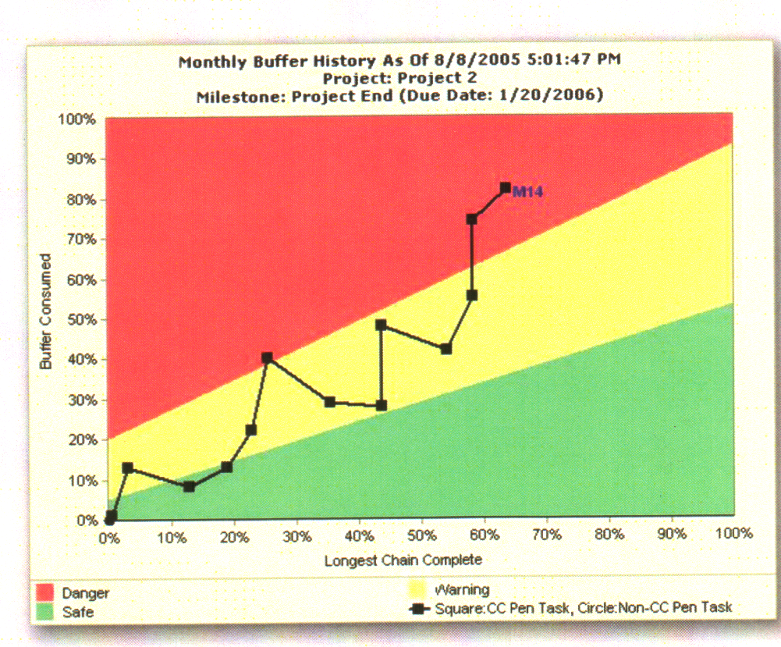
Project Control
Function of rate of Project Buffer Consumption

Slide 99

פרק 4
  ניהול צווארי בקבוק ואילוצים מערכתיים בסביבה רב פרויקטאלית.

Slide 100
ניהול האילוץ: 5 שלבים
זיהוי האילוץ
  צוואר הבקבוק
2. ניצול האילוץ
תעשו את הכול על מנת להוציא 100% מהאילוץ.
3. כפיפות משאבים אחרים
לשמור על ניצול האילוץ:- עדיפות לאילוץ; לא להפריע לאילוץ.
4. להקל על האילוץ
יוזמות על מנת להשיג יותר מ-100%.
5. לחזור לשלב הראשון בטיפול באילוץ הבא.
Notes:
Subordinate – “don’t allow non constraints to interrupt correct flow of throughput to the constraint” – meaning, by keeping the non constraints busy all the time so as to be efficient, what are the chances that a non bottleneck is working in time on WIP that will be needed by the constraint latter in time?
Important to realize – if you don’t look for the new constraint then you let inertia set in; which means allowing a set policy, formal or informal (the way we do business), to stay in place and this then becomes the new constraint as reality changes.
From the Herbie story – the Constraint becomes central part of the solution
– e.g. The first Cosmonaut story - launcing the first man into space. After a day or two there was this constant knocking sound. Tried to stop by finding the source. But he couldn’t find where it as coming from. He had another 25 days in space and he realized that this noise would cause him to loose his mind. So, he closed his mind and he took in this tapping noise and in his mind he turned it into the rhythm of music that he loved and he played in his head that music untill he landed back safely on earth.
- e.g. – A radio station in Perth. Like most radio stations it makes its money from advertisements. It was loosing a significant part of it advertisements to the internet marketing. What it did is that it embraced this obstacle, this constraint , and turned it into an advantage. It offered its sponsors to advertise on the radio their web site.

Slide 101
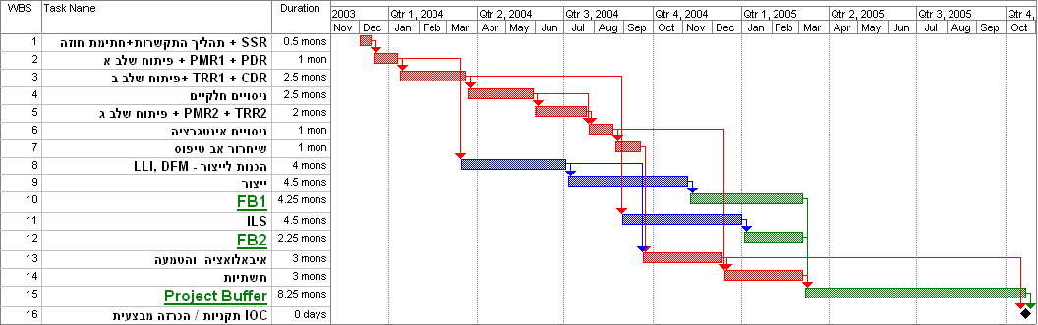
טיפול באילוצי משאב על
שרשרת הקריטית (נתיב קריטי "אמתי" )
האילוץ "זז" על הנתיב הקריטי
זיהוי האילוץ: משאב קריטי

Slide 102
אילוץ המערכתי
בסביבה רב פרויקטאלית
"ההרבי" המערכתי

Slide 103
שלב 2
לנצל את האילוץ

Slide 104
יש לוודא שאנחנו לא מבזבזים את האילוץ – מצב של 100% ניצול/שימוש מועיל של האילוץ.
“An hour wasted by the constraint is an hour wasted by the System as a whole !!! “
Jonah
Notes:
דבר מאוד בסיסי אם יש בזבוז של זמן אצל האילוץ.
Use the Pareto principle to see what % of the constraint’s time is being wasted or not effective and the reasons for that. E.g. ASC’s destroyer program, time is wasted on getting to and coming back from the eating facilities. They set up the eating facilities next to the constraint.

Slide 105
המשך שלב 2 – ניצול האילוץ
צעדים מעשיים:
שתמיד יהיה "חומר" נכון לעבוד עליו.
לשים מחסנית לפני האילוץ לפי סדר נכון.
לא "מבזבזים" את האילוץ
"מחסנית" של משימות לפני האילוץ לפי סדר נכון.
Notes:
Strategic gating is therefore a screening procedure that enables the bottleneck to work most effectively on products that will increase the firm's value. Strategic gating brings about effective utilization of the constraint by giving priority to the most profitable jobs, which is done by using specific contribution measures, amongst other things (see Chapter 11). Strategic gating in a downtown supermarket, where shelf space is the bottleneck, is the decision regarding the products that are to be displayed on the shelves, when there are more than 150,000 Stock Keeping Units (SKUs) available and place for only 15,000 of them.

Slide 106
מטריצת מיקוד
  בחירה בין משימות שונות
  כלי עזר בתהליך של רידוד מפרטים בתהליכי פיתוח
וצאי דופן- בחירה בנושא שהוא קשה לטיפול אך תועלתו גדולה מאוד. או, נושא שהוא קל מאוד לטיפול, אך תרומתו קטנה כדי להוכיח תוצאות בשטח.
מישימות יחסית קלות חשובות ודחופות
VN65752
ג'
א'
'ד'
ה'
ב'

Slide 107
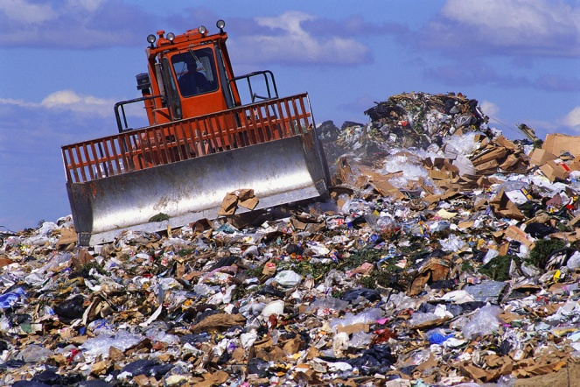
    הפחתת "זמן זבל"
    כאשר צוואר הבקבוק עובד על נושאים שאינם מוסיפים ערך או "מספיק" ערך
    "מובן מאליו"
הגדלת ניצול צוואר בקבוק.
דגש מיוחד עבור מוקדי ידע / תשתית במחסור (יח' ניסוי, ...)

Slide 108
ביטוי "זמן זבל"
    עבודות של "חבל על הזמן" (פגישות, דיונים, בירוקראטיה, פשוט וגוזל זמן.....)
    לא מוכן - חסר KIT –מידע חסר עבור המרט טכני; אישורים עבור ביצוע עבודה : אישור הפרויקט, אישור תכולה, ע"י הספק, ..... ; יוצאים לשטח וחסר ציוד, ספר אחזקה; ....
    אילוץ עושה עבודות של אחרים -דוגמה מהנדס פיתוח שמשקיע בעבודות של רכש.
Notes:
לא מוכן –דורש עבודה חוזרת – דוגמה איש מכירות מגיע לא מוכן לפגישה עם לקוח; צוות פיתוח עובד על מפרט כאשר מסמל דרישות לא סגור עם הלקוח.

Slide 109
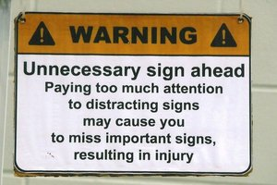
LEAN ניהול הרזה
להוריד את ה "MUDA”
איפיון יתר: מקור מספר ראשון לביזבוז
אחזקה – דרישות יתר
קליטה – דרישות יתר
להקפיד על תרבות של Time to Market – להגביל את הזמן
לשם האתגר המקצועי - למנוע
סינדרם "הקופסה השחרורה" - למנוע

Slide 110
שלב 2 – ניצול האילוץ
צעדים מעשיים:
יש למנוע מהאילוץ מלעבוד על עבודה פגומה.
QC (ביקרת איכות)ו-QA (אבטחת איכות) לפני האילוץ.
סקרי תיכון (Design Reviews) כאבני דרך על הנתיב הקריטי
  פורמט של ה-DR הוא ביטוי ל-QA
  הביצוע של ה-DR הוא ביטוי ל-QC
ניהול תצורה (Configuration Management)
  התהליך של ה- ECO ו-ECR הוא ביטוי ל-QA
  הביצוע של ה- ECO ו-ECR הוא ביטוי ל-QC
Notes:
Min’ Kit – Amdocs is making sure that you have “Closed” the project scope with the customer.
Amdocs – Detailed Design Review

Slide 111
שלב 3
להכפיף לאילוץ

Slide 112
על מנת להפיק את המרב מהמערכת, כל המשאבים שאינם אילוץ צריכים:
לשרת את האילוץ
לא להפריע לאילוץ

Slide 113
המ"מ לא אפשר לאף צוער לעבור את הרבי
מועילות במקום יעילות
  "יעילות" – היחס בין תפוקות לתשומות ברמה מקומית. לעשות דבר נכון!!
  "מועילות" (אפקטיביות) – מעשים בארגון שמביאים אותו קרוב יותר למטרת הארגון.
  לעשות את הדבר הנכון!!
Notes:
Intuitive – for the most part i.e. “The Goal”. Elements of the Critical Chain aren’t although once explained are very logically

Slide 114
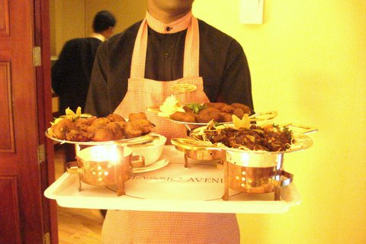

לשרת את האילוץ
עדיפות בטיפול באילוץ
“Treat the NCX10 like gold”
Alex
מע' סדר עדיפויות ברורה כך שמשאבים שהם לא אילוצים
  יתנו סדר עדיפות למשימות עבור האילוץ (לפני ואחרי). – על חשבון יעילות מקומית – עיקרון FLOW של LEAN – LPT
מדיניות של זווד KIT עבור האילוץ – חלק של שיטת KAIZEN – כולל אישור ומידע. דוגמה רכש בתור אילוץ מידע זמין עבור המרט טכני; אישורים גם עבור ההזמנה וגם עבור הספק
Notes:
Maintain flow – eg from The Goal that the set up guys weren’t serving the NX10 – classic eg’ where to be efffective then need to be inefficient at the local level
E.g. – how we serve a surgeon
Kit – two types – The constraint has everything at his disposal to do the task efficiently; he also reserve of critical items (up – kit).
Eg – surgery room. The surgeon is the constraint. Serve his every need, including mopping his brow. A full kit is arranged for him i.e. surgical equ

Slide 115

לא להפריע לאילוץ
לאפשר לאילוץ להתמקד
זה תומך ב- Good Multi tasking
זה מונע - Bad Multi tasking

Slide 116
“Bad” Multi Tasking
Assignments
ביצוע של כל משימה היא יחידה 1 של זמן נטו
A
B
TTM (Time to Market)
מתארך
C
D
E
F
t
1
2
3
4
5
6
Notes:
How do we get into a situation of “bad “ multi tasking to start of with? One of the reasons that we asked for extra time is that we explain that often we are dependent on other resources being available to do an activity that we need its output. Let’s say that we ask for 2 months even though the net time is one month. We “open a time vacuum”; and where there is a vacum it becomes filled; more filled than is consistent to the time space we allowed. Our “super” says OK, but then will come back to us with other assignments so that “G-d forbid” we aren’t wasting time.
Add to that the Multi Project environment – this is the real killer. Other functions in our organization come to us and push assignments onto us since we maybe waiting in any event. Once assignments have been given to me then pressure is applied so as to at least work on these assignments. Pressure is being applied by different customers, internal or external, to show that we are making progress by making sure that we are at least working on the assignments hence we end up jumping from one assignment to the other.
Need to distinguish between how much time it takes to complete a task and how much time we invest in a task. Using bad multitasking no one benefits. Remember the other task(s) in the project have to wait until this task is complete. This goes across the board in a multi project environment.

Slide 117
“Bad” Multi Tasking
+
Multiple Set Up Time
Assignments
A
B
TTM (Time to Market)
מתארך עוד יותר
C
D
E
F
t
1
2
3
4
5
6
Notes:
How do we get into a situation of “bad “ multi tasking to start of with? One of the reasons that we asked for extra time is that we explain that often we are dependent on other resources being available to do an activity that we need its output. Let’s say that we ask for 2 months even though the net time is one month. We “open a time vacuum”; and where there is a vacum it becomes filled; more filled than is consistent to the time space we allowed. Our “super” says OK, but then will come back to us with other assignments so that “G-d forbid” we aren’t wasting time.
Add to that the Multi Project environment – this is the real killer. Other functions in our organization come to us and push assignments onto us since we maybe waiting in any event. Once assignments have been given to me then pressure is applied so as to at least work on these assignments. Pressure is being applied by different customers, internal or external, to show that we are making progress by making sure that we are at least working on the assignments hence we end up jumping from one assignment to the other.
Need to distinguish between how much time it takes to complete a task and how much time we invest in a task. Using bad multitasking no one benefits. Remember the other task(s) in the project have to wait until this task is complete. This goes across the board in a multi project environment.

Slide 118
“Focused” Tasking
Assignments
1 t
A
+
2 t
B
הגדלת התפוקה של האילוץ עקב הקטנת כמות
Set -Ups
3 t
C
4 t
D
5 t
E
6 t
F
t
1
2
3
4
5
6
Notes:
Eg’ of avoiding bad multi tasking. Eli Goldratt tells the story of the F16 Falcon Up project in the mid 1990’s. Yud Aleph Aleph – Yechedat Handassa was the most loaded resource- Each of the engineers had any where in the vicinity of 50 tasks at the same time, and the average lead time on each task was 135 days (that is all the tasks in the yichida). How did we such large #’s of bad multi-tasking and LT – the engineer would go to one of the work-shops or lines to do a related task and invariably he was told that they are busy; so he would go back to his office to work on another problem; as this scenerio repeated itself more problems were opened up and assigned to engineers. Tried pushing as hard as they could with over time. The solution was to limit the engineers to not working on any more then 3 task at any one time; this was enforced even to the extent of being counter intuitive; in other words when an engineer would come and ask for a related task to be done so that he can make progress and he was told that there was no time then he would wait, and after an hour or a few hours there was time. By the end of one month the average LT for ALL tasks (including waiting time for those that hadn’t been assigned) went down to less then 30 days and there was no overtime. Set up times also went down drastically which also accounted for drop of time actually invested hence the engineerrs were able to do more in fact. These figures have been released to public domain – see the Goldratt tapes.
Exercise to show the effect of lost throughput and damaging quality (mistakes, rework) via BMT - you have to consecutively write down the #’s 1,2,3,4,5,6,7,8,9,10 and immediately after that write down the letters of “MULTITASK”. After that you are asked to do MT – write a # followed by a letter from the word “MULTITASKING” i.e. 1M2U3L4T5I6T7A8S9K10. Ask the participants how much longer it took and if there were mistakes, some not founf and others found that need to be reworked.
Why is it that between 25% and 50% of people report feeling overwhelmed or burned out at work?
It's not just the number of hours we're working, but also the fact that we spend too many continuous hours juggling too many things at the same time.
What we've lost, above all, are stopping points, finish lines and boundaries. Technology has blurred them beyond recognition. Wherever we go, our work follows us, on our digital devices, ever insistent and intrusive. It's like an itch we can't resist scratching, even though scratching invariably makes it worse.
Tell the truth: Do you answer email during conference calls (and sometimes even during calls with one other person)? Do you bring your laptop to meetings and then pretend you're taking notes while you surf the net? Do you eat lunch at your desk? Do you make calls while you're driving, and even send the occasional text, even though you know you shouldn't?
The biggest cost — assuming you don't crash — is to your productivity. In part, that's a simple consequence of splitting your attention, so that you're partially engaged in multiple activities but rarely fully engaged in any one. In part, it's because when you switch away from a primary task to do something else, you're increasing the time it takes to finish that task by an average of 25 per cent.
But most insidiously, it's because if you're always doing something, you're relentlessly burning down your available reservoir of energy over the course of every day, so you have less available with every passing hour.
I know this from my own experience. I get two to three times as much writing accomplished when I focus without interruption for a designated period of time and then take a real break, away from my desk. The best way for an organization to fuel higher productivity and more innovative thinking is to strongly encourage finite periods of absorbed focus, as well as shorter periods of real renewal.
If you're a manager, here are three policies worth promoting:
1. Maintain meeting discipline. Schedule meetings for 45 minutes, rather than an hour or longer, so participants can stay focused, take time afterward to reflect on what's been discussed, and recover before the next obligation. Start all meetings at a precise time, end at a precise time, and insist that all digital devices be turned off throughout the meeting.
2. Stop demanding or expecting instant responsiveness at every moment of the day. It forces your people into reactive mode, fractures their attention, and makes it difficult for them to sustain attention on their priorities. Let them turn off their email at certain times. If it's urgent, you can call them — but that won't happen very often.
3. Encourage renewal. Create at least one time during the day when you encourage your people to stop working and take a break. Offer a midafternoon class in yoga, or meditation, organize a group walk or workout, or consider creating a renewal room where people can relax, or take a nap.
It's also up to individuals to set their own boundaries. Consider these three behaviors for yourself:
1. Do the most important thing first in the morning, preferably without interruption, for 60 to 90 minutes, with a clear start and stop time. If possible, work in a private space during this period, or with sound-reducing earphones. Finally, resist every impulse to distraction, knowing that you have a designated stopping point. The more absorbed you can get, the more productive you'll be. When you're done, take at least a few minutes to renew.
2. Establish regular, scheduled times to think more long term, creatively, or strategically. If you don't, you'll constantly succumb to the tyranny of the urgent. Also, find a different environment in which to do this activity — preferably one that's relaxed and conducive to open-ended thinking.
3. Take real and regular vacations. Real means that when you're off, you're truly disconnecting from work. Regular means several times a year if possible, even if some are only two or three days added to a weekend. The research strongly suggests that you'll be far healthier if you take all of your vacation time, and more productive overall.
A single principle lies at the heart of all these suggestions. When you're engaged at work, fully engage, for defined periods of time. When you're renewing, truly renew. Make waves. Stop living your life in the gray zone.
More blog posts by Tony Schwartz More on: Managing yourself, Personal effectiveness, Productivity

Slide 119
סיכום ביניים...
לא הוספנו משאב נוסף
כן שנינו את הדרך בו מנהלים את המערכת
הצלחנו להשיג הרבה יותר עם מה שיש
התקרבנו למטרה שלנו

Slide 120

כיצד נוכל לסייע עוד לאילוץ?
שלב 4 – להקל על האילוץ
לשנות את "התכן" של האילוץ או
את המע' שתומכת באילוץ

Slide 121
שלב יותר קשה.
לבצע בסוך
צעדים להגדיל את הקיבולת של האילוץ
לקנות עוד קיבולת (עוד כ"א, ציוד, תשתית, שע' נוספות, מיקור חוץ..) – מותנה לניתוח עלות / תועלת.
שיפור תכן של האילוץ ו/או תהליכי עבודה של האילוץ
להוריד משימות מהאילוץ למשאבים אחרים Off Loading

Slide 122
צעדים מעשיים:
להתמקד בשיפורים של התפוקה באילוץ - KAIZEN ניתן לעשות Value Streaming
התהליך מתועד ע"י תרשים זרימה
Value Streaming – דוגמה תיק מוצר / תיק ייצור
  לבטל בזבוזץ
      Overspec
      חזרות
      אין צורך "בשביל מה"!!
  תוספת ערך ע"י שינוי תפקיד
  מוקד ידע מנהל
Notes:
Even though “overspec” appeared also in the “exploit” section, if we need to invest significant amount of time & effort &/or money, then it is in the “elevate” section.
Amdocs – our Expert – modify his job – more emphasis on reviewing Design Documents rather than writing them

Slide 123
צעדים מעשיים: שינוי תכן – פעולות במקביל
עבור הנתיב הקריטי.
A
B
E
F
A
B
E
F
B
B
E
F
E
F
Notes:
Commercial world – releasing a new product - many activities can be done in // - export licence; organizing the installation team, Marcom… lots of papaerwork
I have an idea for my Constraint management presentation on Project management - how to elevate the constraint? - make the critical chain shorten the time even more by seeing if we can do activities that were previously on the critical chain in parrellel. Same idea can also be put in my traditional Pert presentation. Eg' is from Machleket Binui - at the same time that Toar tashtiot is develpping its bakhasha la' badat, the kazin project in anaf projectim is forming his team of consultants for answeing the bakhasha la badhat
Amdocs – emphasis in the upfront planning “Critical Path Analysis”

Slide 124
צעדים מעשיים: שינוי תכן – מנות מעבר יותר קטנות
Development
A
Testing
B
Integration
E
A1
A2
B1
B2
E1
E2
Notes:
Redesigning with smaller transfer batches on the critical path. Eg’ design drawings can be divided up into smaller transfer batches so that other teams can commence their activities earlier.
Note that the smaller the transfer batch the less time required to complete the entire mission.
Amdocs – at present work on “Big Blocks” so as to limit WIP. Need to weigh up carefully.

Slide 125
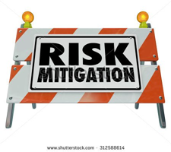
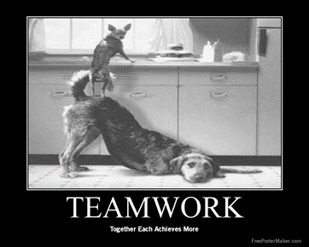

המשך צעדים מעשיים:
השקעה בהכנת זווד – KITעבור האילוץ
פעילות עם סיכון גבוה יש להקדים
  ישום של הנדסה משולבת
  Concurrent Engineering
פתרון אפשרי – "צוות אדום"
Notes:
For instance, analyzing the daily calendars of sales people and interviewing them in dozens of organizations around the globe reveals that their effective utilization of time is usually less than 50%. In other words, over 50% of their time is considered "garbage time" (missed appointments, additional meetings because of an "incomplete kit" of information, etc.)
Providing a full kit & this kit has had a QC done on it. Even though we spoke of providing a kit earlier, if a significant effort is required then it is in the “elevate” section.
Preempting risk factors – Amdocs does early testing on integration where possible.
Concurrent engineering was also raised in the “exploitation” stage. However if it is not part of the organization’s culture & has to be invested in then it in the “elevating” section. Amdocs: input from the “testing teams” are involved upfront in the design (e.g.’TACT” (volume); Debuging; ); R&D from the PBG

Slide 126

המשך צעדים מעשיים:
צמצום עבודות Setup באילוץ מערכתי ע"י:
  קיבוץ הזמנות (אצווה) באילוץ.
  שינוי תכן.
Off loadingמהאילוץ למשאבים אחרים (שאינם אילוץ), אפילו שזה נראה לא "יעיל" עבורם. לא לשכוח שנדרש "תמריץ".
קניית תוספת קיבולת / יעילות עבור האילוץ :מע' CRM ; תוכנת ; Work Flow שירות' יעוץ; מיקור חוץ..
Notes:
Off loading – Amdocs – Expert in Design, some of the assignments can be off loaded. Encourages versatility.

Slide 127
שלב 5
לזהות את האילוץ החדש

Slide 128
לאחר ש"שברנו" את האילוץ...
"זהה את האילוץ הבא , וחזור לשלב 1"
(אחרת יש סכנה של אינרציה וזה הופך להיות האילוץ החדש)
שלב 5 -
אילוץ חדש
Notes:
Important to realize – if you don’t look for the new constraint then you let inertia set in; which means allowing a set policy, formal or informal (the way we do business), to stay in place and this then becomes the new constraint as reality changes.
Strategic Aspects of the Theory of Constraints
The discussion so far related to constraint management in the context of short-term utilization of existing resources and demands. Taking the medium-term and long-term strategic view, three interesting questions need to be asked concerning the system constraint:
Where should the system constraint be located?
Where is the constraint located now?
How to move the constraint to its right position?
The first strategic question focuses on the position of the constraint in the system: does the organization view the system’s main constraint as a resource constraint, that is, should the system constraint be a bottleneck, or should it work at excess capacity. A system with excess capacity can always answer market needs, exploiting every opportunity that arises. It can cope with fluctuations in demand and with uncertainty, and can prevent competitors from entering the market. The disadvantage of such a system is the cost of the excess resources.
Deciding on an internal bottleneck has the distinct advantage of allowing the organization to act more efficiently in exploiting and operating its resources, at lower costs not to mention the fact that it is easier to control a system with an internal resource constraint. The organization can, in this case, choose the work it takes on, in accordance with its strategic and tactical considerations. A distinct disadvantage of the internal resource constraint is that it means rejecting orders and projects due to lack of capacity, which can allow competitors to gain a foothold. Working in a resource-constrained environment is also likely to lead to longer lead times and lower levels of customer service. Nevertheless, should the organization decide that the constraint is to be an internal resource it should be the most expensive or the most critical resource.

Slide 129
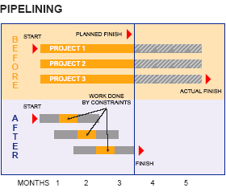
Multi-Project Environment
Notes:
Release projects into execution based on the most limiting resources.
With one project, it is good to get a head start (after all uncertainties will happen). A project should begin as soon as it is approved! To the contrary, in a multi-project world, starting all
projects ASAP is counterproductive- it creates unnecessary bottlenecks, gives rise to confusion about priorities, and induces multitasking. Management headaches skyrocket, productivity takes a nose dive, and all projects end up taking twice as long to finish.
Multi-project success starts with acknowledging that the most heavily loaded resources (constraints) determine how many projects can be done. Releasing projects faster than what
constraints can handle doesn't do anyone any good. Therefore, the first rule of multi-project success is to select the most profitable project mix given the constraints, and release work into execution based on the availability of those constraints.
The reason we fall into the trap of bad multi tasking is that we get caught up with efficiencies rather than effectiveness. Management finds it difficult no to allow a project to commence if it has resources available to start. This is just like flooding the shop floor because we have resources available – efficient but not effective, and in fact causes damage with setting up the environment to “take the fall” of bad multi tasking.
As a thumb rule, if you want to get quick tangible and sustainable results, simply reduce the amount of open projects by 25%. (however in some organizations the bad multi tasking is so bad that a reduction of 25% is not enough). This will immediately reduce tremendously the effect of bad multi tasking. This can be done without putting in the full CCPM methodology. It is critical to get a quick result so we will need to freeze in the beginning some of the projects through prioritizing by management.
Pipeline – Limit the number of projects in execution based on the most limited resources. Since you can carry out only as many projects as you can get through the most limited resources, releasing more projects will only spread your resources thin. Enforce this rule even if it means leaving other resources idle.
Pipelining releases work in a metered fashion, similar to traffic lights releasing cars into the freeway. By concentrating resources on fewer projects, projects are completed faster; capacity opens up; and the organization can do more projects.
A side benefit of Pipelining is that the extra time (before projects can be released into execution) can be used for preparation or “full-kitting.” At last, the organization has ample time to properly prepare drawings and specifications, get approvals, order materials, and test plans. As they say, well begun is half done!

Slide 130
הגדרת Constraint Innovation (C.I.)
מסגרת אינטואיטיבית לניהול אפקטיבי של מערכת כל שהיא.

Slide 131
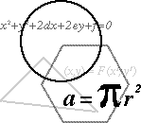
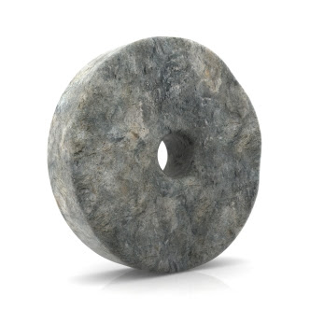


בעיות מסובכות ......
נפתרות ע"י
פתרונות פשוטים
CI

Slide 132
תודה
לואיס טריגר
#054-5323553 e-mail : trigalon@LewisTrigger.com
WWW.LewisTrigger.com

